Slide 2
Chapter 12
Implementation and Evaluation of an EHR System

Slide 3
Chapter Topics
Overview of EHR implementation processes
Organizational planning related to EHR implementation
Tools and processes related to workflow analysis
Considerations related to vendor selection
Various costs related to EHR system ownership
Relationship between EHR implementation and Meaningful Use EHR Incentive Programs

Slide 4
Objectives
Define the goals of the Certification Commission for Health Information Technology.
Explain the incentive criteria for electronic health record (EHR) systems developed by the Centers for Medicare and Medicaid Services.
Describe how to assess a healthcare facility’s readiness for the implementation of an EHR system.
Evaluate and create a healthcare facility’s goals for an EHR system.
Examine an EHR migration plan.
Explain the workflow analysis.
Understand the total cost of ownership.
Describe the evaluation process for EHR systems.
Examine a request for proposal and an implementation plan.
Assess stages of meaningful use.

Slide 5
Initial Steps in Implementing an EHR System
The HITECH Act accelerated EHR implementation nationwide
Hospitals and eligible providers seeking meaningful use incentive payments must implement an EHR system certified by the Office of the National Coordinator–Authorized Testing and Certification Bodies (ONC–ATCB)
The Certification Commission on Health Information Technology (CCHIT) is a ONC–ATCB that developed rigorous processes to examine functionality, interoperability, and security of EHR systems
Initial steps in implementing an EHR system include:
Assessing readiness
Setting goals
Establishing a steering committee
Assigning a project manager

Slide 6
Initial Steps in Implementing an EHR System
Organizational readiness prior to EHR implementation must be understood
The following types of resources require consideration:
Capabilities of existing clinical, financial, and administrative computer applications
Staffing resources available to support existing applications
The following reporting needs are accounted for:
Hospital utilization
Gross patient revenue
Emergency visits
Cultural considerations related to change management and process improvement are evaluated early in the process of implementing an EHR system
A facility must appreciate the distinction between implementation and adoption
Notes:
All items considered on this page should be thought of in every relevant context – to include resources of all varieties.

Slide 7
Initial Steps in Implementing an EHR System
After readiness is assessed, the organization must identify and establish goals related to an EHR system and the value it may bring the organization
Goals vary somewhat from organization to organization
At a minimum, many goals stem from the following objectives:
Improved quality of care
Increased revenue
Improved operational efficiency
Supervised compliance
Improved reporting
Notes:
It is important to identify goals that can be achieved by using an EHR system early in the process. Understanding how these systems can help achievement of important goals allow for buy-in and commitment among the workforce.

Slide 8
Initial Steps in Implementing an EHR System
An internal cross-disciplinary steering committee is established to work on the EHR implementation project
A typical steering committee is comprised of:
Clinicians
Health information professionals
Administrators
Financial staff
Other relevant staff members
This committee comes to a consensus regarding needed infrastructure changes necessary for EHR implementation as well as identify steps that help ensure successful migration to an EHR
Ongoing and consistent meeting times are established and include meetings prior to and during implementation

Slide 9
Initial Steps in Implementing an EHR System
Assigning a project manager is the next logical step for an organization; options include hiring an internal or external project manager
Considerations related to an internal project manager:
Individual understands the organizational culture and structure
Individual has vested interest in implementation success
Individual is on-site and readily available
One risk is that the individual may lack objectivity in decision-making
Considerations related to an external project manager:
Individual is neutral and objective
One risk is that the individual will have to spend extensive time learning the culture, structure, and stakeholders
Necessary qualities of a project manager:
Effective in communication, facilitation, negotiation, leadership delegation, and follow-up
Should understand healthcare and clinical information
Notes:
Another consideration related to external project managers is that they are typically not on board until the migration process begins and generally are not readily available immediately upon implementation; therefore, long-term adoption issues are often not addressed by an external project manager

Slide 10
Initial Steps in Implementing an EHR System
The project manager handles all issues related to EHR selection and implementation
Issues include the transition from paper to EHRs, as well as technical limitations among staff
The project manager works closely with the IT department and vendor
This person also leads processes in identifying user roles and managing staff training

Slide 11
Checkpoint: Your Turn
True or false: A steering committee established for the purpose of EHR implementation only consists of clinical professionals.
True
False
True or false: An effective project manager should be able to delegate.
True
False

Slide 12
Migration Plan
A migration plan provides the framework for identifying basic steps that require completion during the paper health record to EHR transition
The following shows five key migration plan steps
Migration Step | Description
Identify requirements | Identify scope of project and user needs
Create a design | Illustrated blue print of the paper to EHR transition
Analyze current systems | Examine how facility currently uses records and performs tasks
Test the functionality | Test functionality of the new EHR system
Create time line for implementation | Create tools such as Gantt charts that account for schedules, resources, and dependencies

Slide 13
Migration Plan
Investing appropriate time and effort into developing a migration plan greatly enhances the rewards of EHR implementation
A migration plan must be fluid to account for the unexpected and manage those variances effectively
A complete assessment, to include periphery information systems in ancillary departments, must be accounted for in the migration plan
Figure 12.1 shows typical time line a project manager could use in these processes

Slide 14
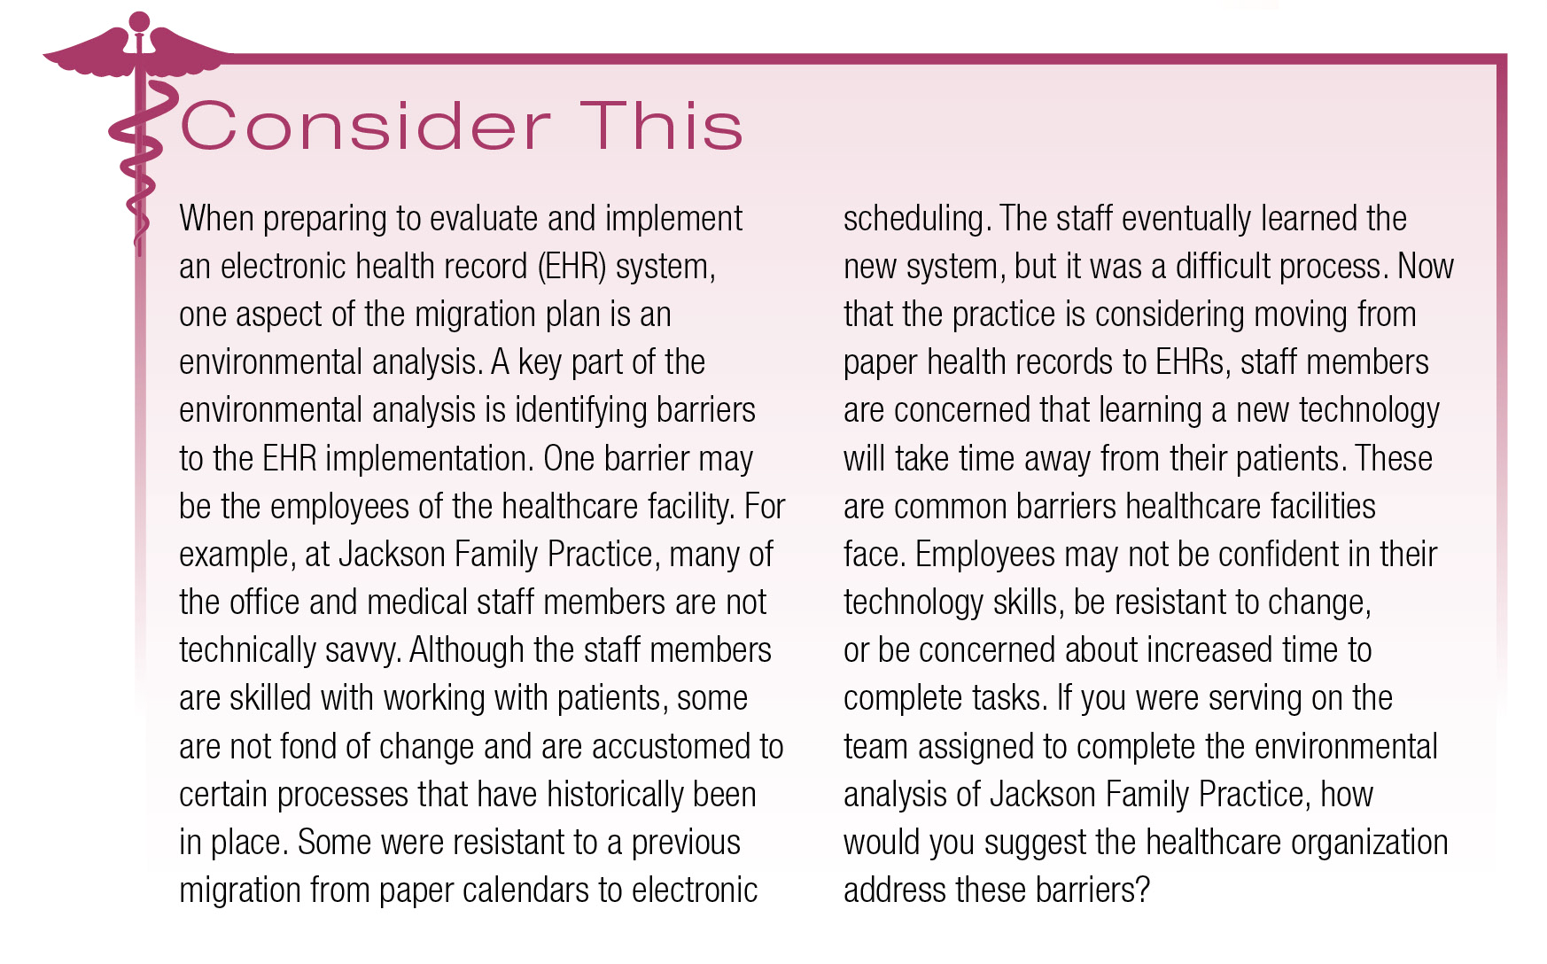
Consider This: Discussion

Slide 15
Analyzing Workflow
Workflow analysis includes the review of current organizational functions and uses of paper records; this occurs with multi-stakeholder involvement
Workflow analysis considers:
Front- and back-office functions
HIM functions
Provider/care processes
Stakeholders typically include:
HIM professionals
Physicians
Nurses
IT staff
Various managers
Notes:
This analysis informs how EHR implementation will modify, enhance, or eliminate organizational processes or tasks

Slide 16
Analyzing Workflow
Flowcharts are commonly used in workflow analysis
Flowcharts help identify breakdowns, insufficiencies, or bottle necks in existing workflow
A variety of approaches can be used for workflow analysis such as:
Establish a team from different departments
Assign staff members to perform their job functions and conduct analysis
Conduct internal analyses versus using vendor support
Assign overall workflow responsibility to the project manager or other identified staff member
Use role reversal techniques by stepping into the patient or other customer shoes to understand workflow
Require staff members to construct detailed descriptions of their routine tasks, actions, and sequences on the job

Slide 17
Analyzing Workflow
During workflow analysis all forms used by the organization are collected, reviewed, and accounted for
Understanding the content and uses of forms ensures their appropriate inclusion in the EHR system
Desired outcomes of workflow analysis include:
Setting realistic expectations related to software functionality
Streamlining processes and improving communication
Coordinating treatment and improving quality of care
Notes:
Workflow analysis outcomes benefit the facility, staff, and patients.

Slide 18
Vendor Selection
When selecting a vendor an organization must appreciate that they are establishing a potential long-term relationship
Vendor selection must be thoughtful and include all necessary employee representatives
Organizations may find value in hiring an outside consultant to assist with vendor selection
Organizations may chose to build their own system, use several applications from a variety of vendors, or select an integrated system

Slide 19
Vendor Selection
A steering committee may consider the following when selecting a vendor:
Does the vendor have support staff, financial resources, and capabilities to meet organizational needs?
Does the vendor have management expertise to ensure all tasks are completed related to EHR implementation?
Is continued research and development a priority for the vendor?
Is the vendor knowledgeable of government certification/regulations of EHR systems?
Does the vendor offer a functional and adaptive EHR product?
Does the vendor offer training and technical support?
Does the vendor have favorable ratings/reviews by other healthcare organizations?

Slide 20
Vendor Selection
In 2006 CCHIT began certifying EHR systems
The U.S. government recognizes CCHIT as a certifying organization for EHR systems
CCHIT certification is based on 400+ criteria encompassing functionality, interoperability, and security
CCHIT awards EHR certification based on the type of facility the EHR product is designed for such as:
Ambulatory
Inpatient
Emergency department
Behavioral health
Notes:
CCHIT also awards certification for long-term settings, post-acute care, and e-Prescribing.

Slide 21
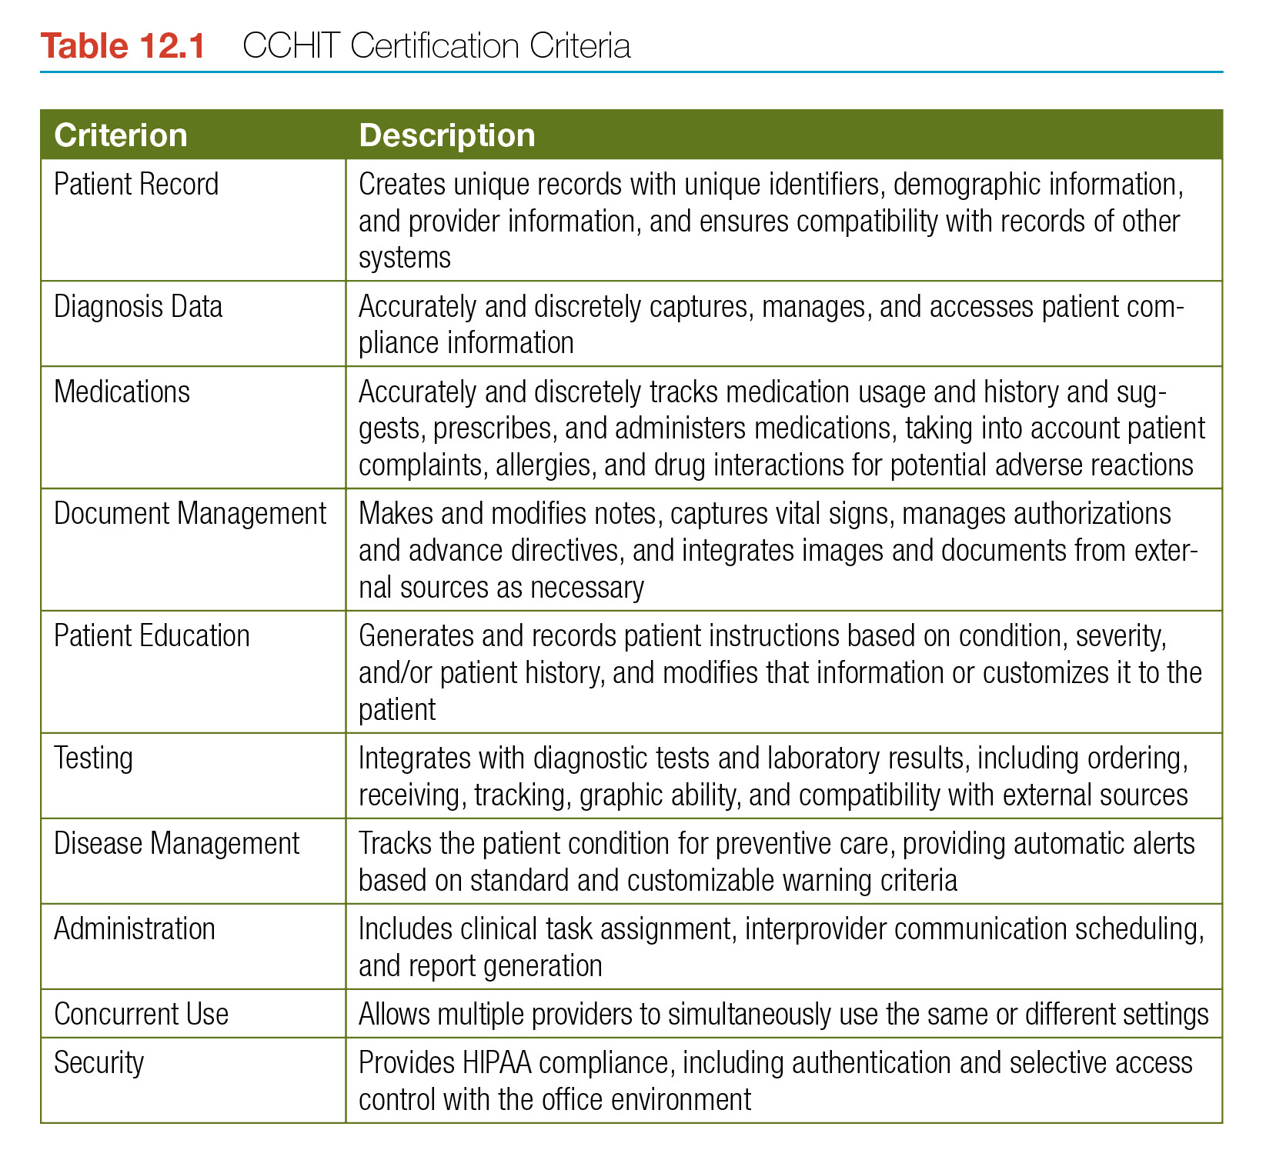
Vendor Selection
Table 12.1 provides an example of some CCHIT certification criteria

Slide 22
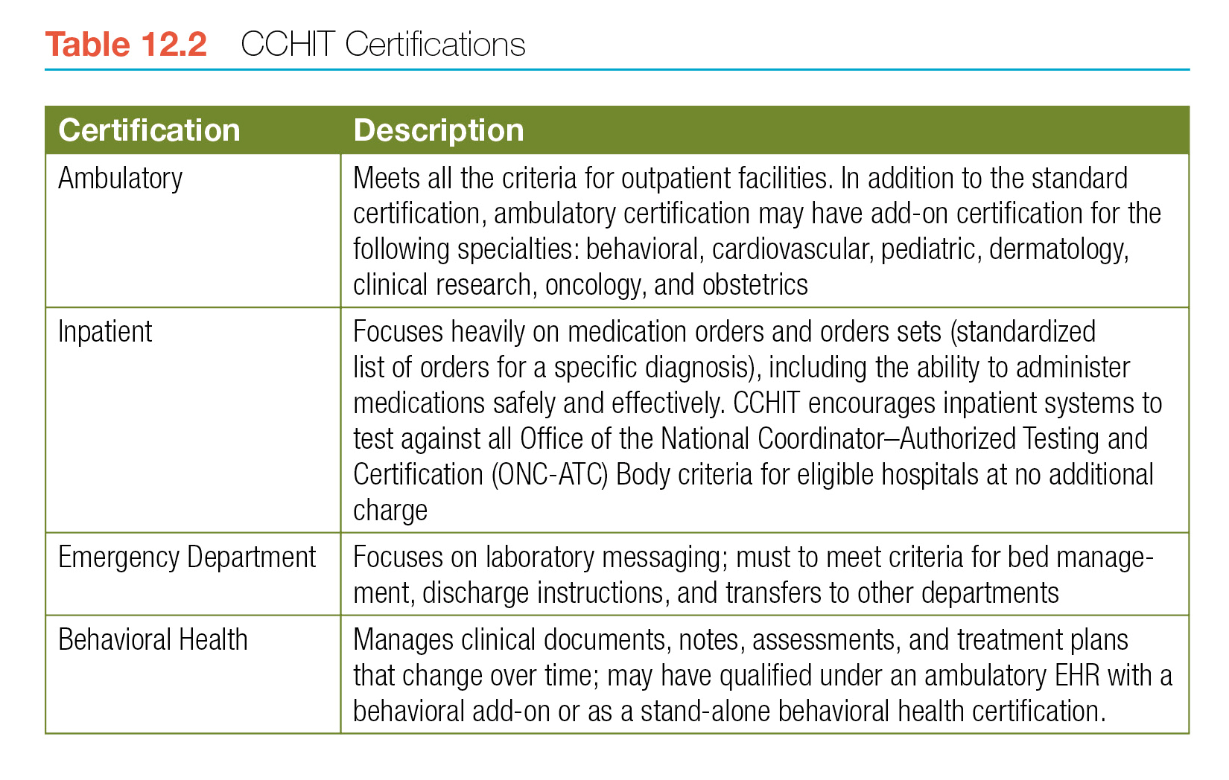
Vendor Selection
Table 12.2 illustrates CCHIT certifications

Slide 23
Vendor Selection
As part of the vendor selection process the steering committee requests on on-site or online demonstration from vendors
After demonstrations the committee evaluates the systems based on a previously developed assessment tool–this evaluates if the EHR systems meet the needs of the organization
After systems are evaluated a short list of potential EHR systems are created
From this list a request for proposal (RFP) is submitted to vendors; the RFP indicates to the vendor that the facility would like a quote provided
After all received RFPs are received and reviewed by the steering committee an EHR system is selected

Slide 24
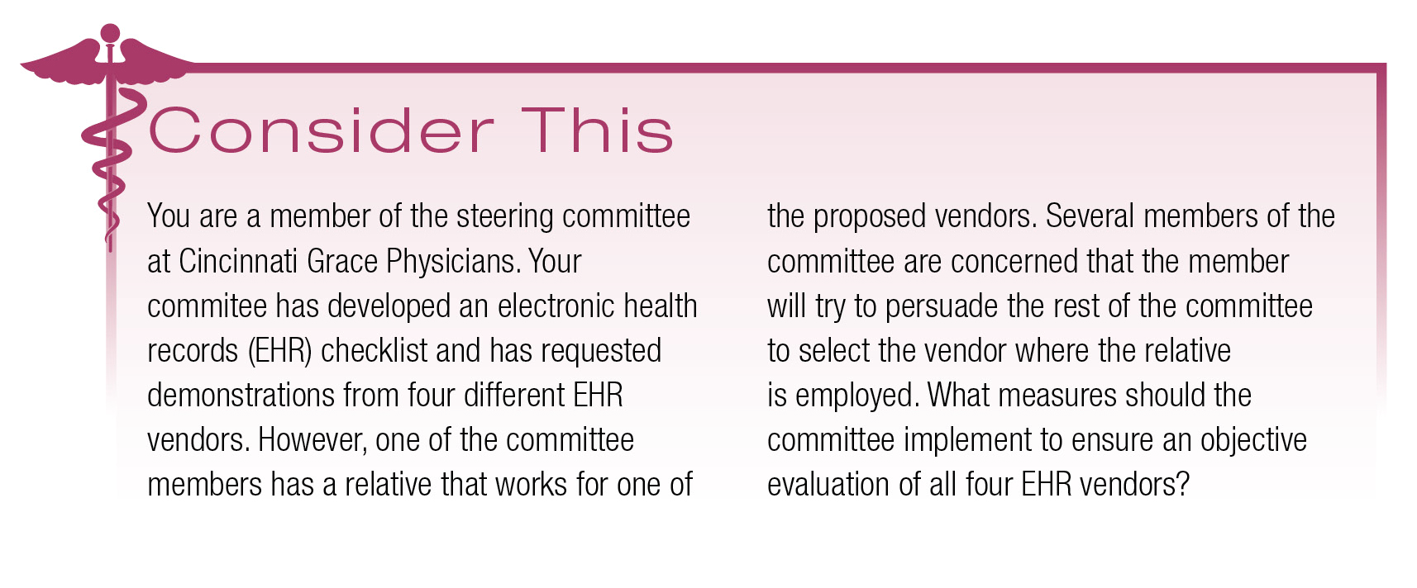
Consider This: Discussion

Slide 25
Total Cost of Ownership
Implementing an EHR system is a long-term financial investment
An organization must consider accounting, opportunity, and economic costs as well as other general financial considerations related to EHR systems
Type of Cost | Description
Accounting costs | Total amount of money paid out for products, goods, or services; includes direct costs of an EHR system such as hardware, software, productivity loss, implementation, support, and software licenses
Opportunity costs | Value of a decision that isn’t depicted on an accounting spreadsheet; example: risk of losing patients over time if the organization does not embrace technology
Economic costs | Combination of accounting and opportunity costs

Slide 26
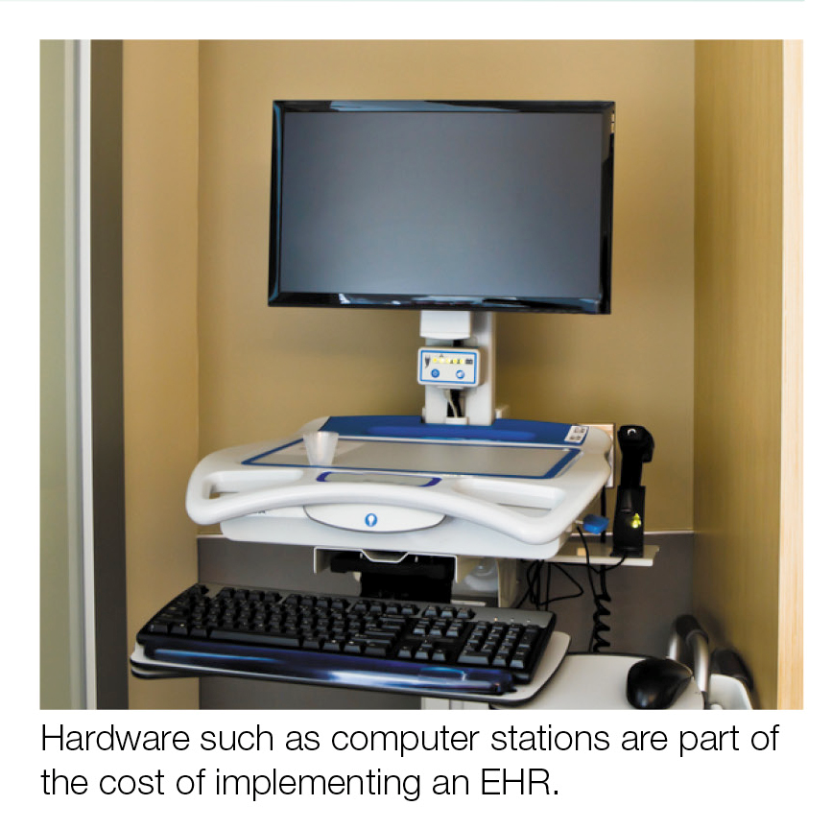
Total Cost of Ownership
Additional financial expenditures related to EHR systems include:
Additional hiring of health informatics staff
Additional hiring of technical support staff
Workflow analysis related expenses
Provision of EHR training to all employees
Ongoing creation/revision of data dictionaries and templates

Slide 27
Total Cost of Ownership
Other factors of financial impact related to EHR systems:
Hardware–initial cost, maintenance, and potential replacement
Software–license fees, electronic claims and remittance, e-prescribing costs
Implementation and training–cost of installation, build, testing, and training with the EHR system
Maintenance–annual fees for upgrades, support, training, and customization
Downtime and recovery–depending on the type of EHR system (web-based or on-site servers)
Regular maintenance on an EHR system is essential so the system supports/identifies:
Latest evidence-based medicine
New and recalled drugs
New disease terminology
New processes and workflows due to external factors (example: reimbursement)

Slide 28
Total Cost of Ownership
healthcare facilities may perform cost-benefit analyses to determine their return on investment (ROI) with an EHR system
ROI is a performance measurement that calculates the benefits or gains of an investment
If a payback window is greater than five years the investment may not demonstrate worthiness; moving toward a less expensive EHR system may be necessary in some instances
Internal rate of return (IRR) and net present value (NPV) are calculated for the purpose of comparing potential EHR systems against each other
IRR measures the profitability of a system (in this instance an EHR system)
NPV is the present cash flow minus the purchase price of goods or services
Notes:
Vendors routinely provide ROI analysis to potential customers. This data is appreciated but should be viewed and studied with caution because of the potential positive bias on the part of the vendor who is also trying to sell a product

Slide 29
Total Cost of Ownership
Healthcare facilities also have to evaluate traditional financial costs with other benefits
EHRs provide a variety of benefits including improved efficiencies, potential long-term financial savings, enhanced quality of care, and enriched compliance efforts
After financial data is analyzed and considered in the contexts of other benefits, the facility identifies the level of acceptance among its workforce related to EHRs
If staff do not accept the concept of EHRs, the path toward implementation and eventual adoption is challenging

Slide 30
Checkpoint: Your Turn
True or false: Flowcharts are commonly used during workflow analysis.
True
False
True or false: Opportunity costs are clearly depicted on accounting spreadsheets.
True
False

Slide 31
Consider This: Discussion

Slide 32
EHR Implementation
Fear and lack of management support often leads to implementation failure; effective leadership is essential during these processes
The steering committee must identify champions from within the organization in all areas of the organization to drive enthusiasm and support among staff
Once the EHR system is selected and it is time to rollout the system, the rollout consists of three phases:
Organizational phase
Training phase
Operational phase

Slide 33
EHR Implementation
The organizational phase of the rollout entails all preparatory planning for installation of the EHR system
The training phase focuses on comprehensive learning, fine-tuning, customizing, and testing of the EHR system
Rollout ends with the operational phase; this phase includes the launching of the system and continual training while maintenance begins
Prior to a go-live date extensive testing related to hardware, software, backup, networking, connectivity, and recovery are essential
In preparation of go-live, many of the testing processes noted above occur in a test environment prior to facility-wide rollout
Notes:
During the organizational phase is when paper records are initially converted to EHRs.

Slide 34
Consider This: Discussion

Slide 35
Meaningful Use
Meaningful use conceptualizes effective communication and delivery of healthcare services as occurring through effective use of EHRs
Meaningful use consists of three stages; the three stages of meaningful use focus on specified aspects of using EHR systems
To receive incentive payments throughout the three stages of meaningful use, the hospital or eligible provider must:
Meet guidelines of the Medicaid EHR Incentive Program or Medicare EHR Incentive Program
Implement an EHR system
Adopt an EHR system
Upgrade an EHR system

Slide 36
Chapter Summary
Transitioning from paper health records to EHRs poses challenges; an effective transition requires thoughtful planning
A healthcare organization must assess EHR readiness, form a steering committee, set goals, and establish a migration plan; this should be a cross-disciplinary approach
A project manager provides essential leadership throughout EHR implementation
The steering committee also conducts workflow analysis and cost-benefit analysis and shares findings with administration
From here the steering committee views EHR demonstrations, assesses potential systems, and send RFPs to select group of vendors
Careful formulation of rollout processes occurs to include an identified go-live date
Internal champions are identified to foster engagement, buy-in, and support from staff to help ensure a smooth EHR implementation

