Slide 1
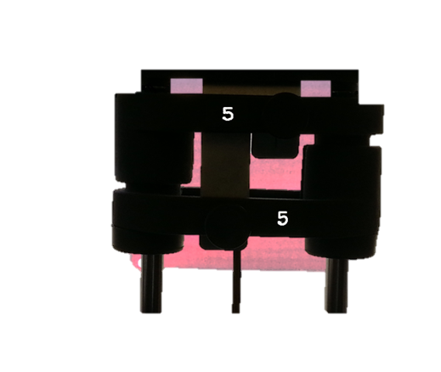
The Right Fit
Company Overview
Your Name

Slide 2
Overview
Company Description
Equipment and Fitness Classes
Expansion Plans

Slide 3
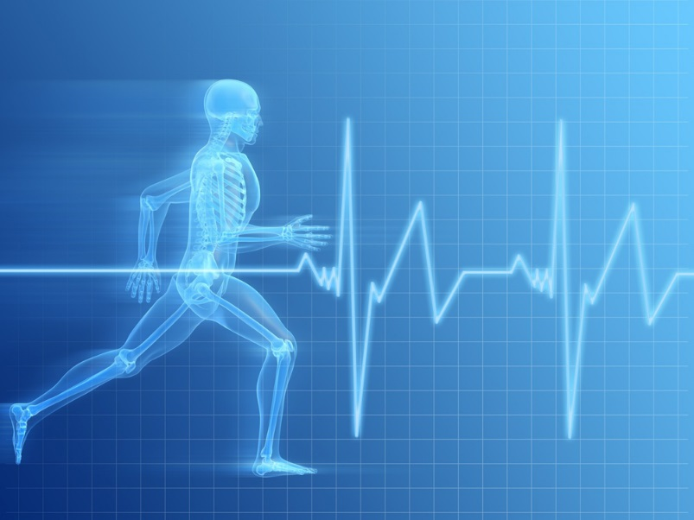
Company Description
The Right Fit operates a 20,000 square foot state-of-the-art gym and fitness facility in San Diego, California. A team of highly motivated trainers provides personalized fitness assessments, develops training programs, and leads fitness classes seven days a week.

Slide 4
Equipment
Treadmills
Stationary Bicycles
Weights
Ellipticals
Strength Machines

Slide 5
Fitness Classes
Step Aerobics
Low Impact Dance
Cardio Boot Camp
Low Impact Mild
Stretch and Strength
Pilates

Slide 6
Expansion Plans
2 new branches
Expand corporate
Franchising

