Slide 1
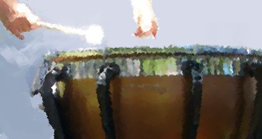
ChildPlay
Teaching values through music

Slide 2
Ages Served

