Slide 1
Solar Flares
How do they affect us?

Slide 2
What is a solar flare?
A magnetic storm on the sun
A large energy release
A glow , then…
A huge ejection into space
Electrons, atoms, and ions
X-rays

Slide 3
More about flares
Happen around sunspots
Sunspots: Dark, cool spots on the sun
Particle cloud reach earth in 2 days
Occur in cycles

Slide 4
How do flares affect earth?
Disrupt radio signals
Disturb radar stations
Can affect “cyberspace”
Radiation storm can endanger astronauts
Northern lights visible in more places

Slide 5
Ejection phase can disrupt
GPS systems
Airline flights
Satellite communications
Cell phones
Fuel pumps
Computerized cars controls

Slide 6
Satellite communications
Financial transactions
Electrical grid power surges
Blow out transformers
Equipment is hard to replace
Safety of ships at sea

Slide 7
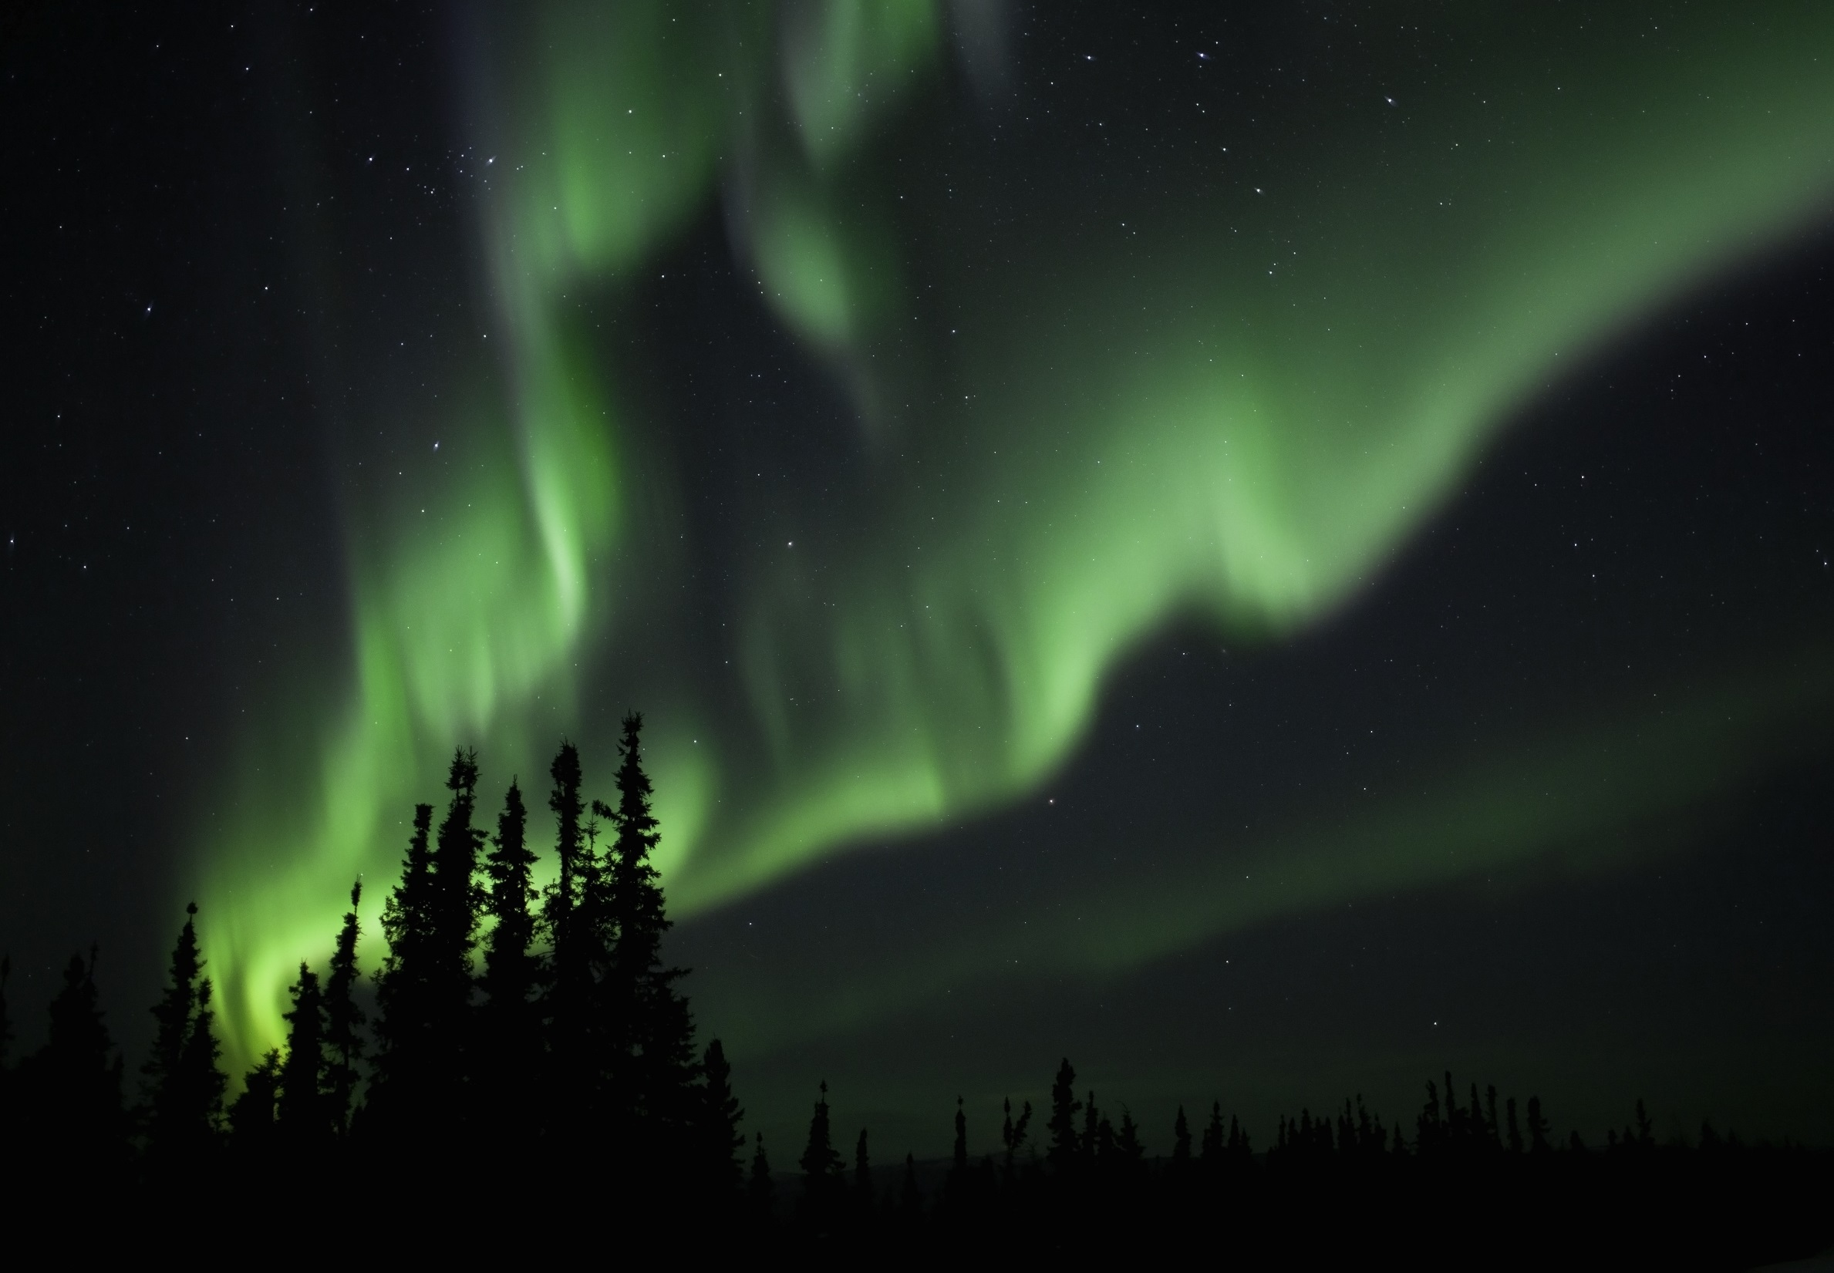
The 1859 solar flare
Called the “Carrington Event”
Telegraphs stopped working
Northern lights visible in Italy, Cuba, and Hawai‘i

Slide 8
Can we watch them from earth?
Not visible with home telescopes
Or even with these telescopes
Only high-powered professional telescopes

