Slide 1
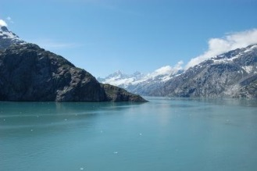
Tour Alaska!
Tour the World Travel Agency
Your Guide to Beauty and Adventure

Slide 2
2016 Tour Dates
July 10-18: The Explorer
Seattle – Vancouver – Glacier Bay – Skagway – Juneau - Ketchikan
August 3-10: Off the Beaten Path
Seattle – Vancouver – Skagway – College Fjord – Whittier – Anchorage – Denali National Park
August 20-28: Denali Special
Seattle – Whittier – Anchorage – Talkeetna – Denali National Park

Slide 3
Fly to Seattle
We book your travel to Seattle
Airline of your choice
Transportation provided from airport to docks
Easy transfer to ship
Welcome reception provided on deck at departure

Slide 4
Whale Watching
Small group excursions
Humpback whale summer displays
See rare bubblenet feeding

Slide 5
Glaciers
Margerie Glacier
Mendenhall Glacier
Gilman Glacier
Johns Hopkins Glacier

Slide 6
Our History
We know Alaska
25-year history in the business
Certified guides
Customizable tours
Read our reviews
Top rated by Tour Rating Service

Slide 7
Questions?
Our team is happy to answer any questions you may have

