Slide 1
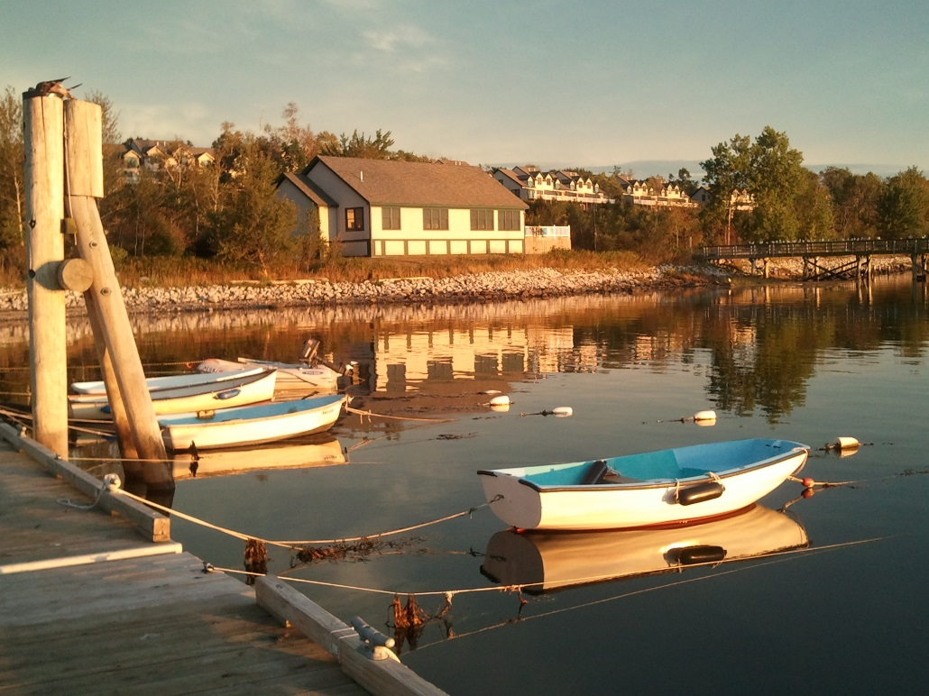
Watercraft
Outdoor Designs

Slide 2
Canoes
Lightness
Strength
Stability
Solo
Tandem
Inflatable
Wood
Whitewater

Slide 3
Solo Canoes
10’ to 18’ lengths
15 to 40 lbs.
Materials
Fiberglass
Wood plank
Carbon
Speed & efficiency
Most Popular Solo Models
Model | Length | Weight
Glider | 12’ | 22 lbs.
Rollalong | 14’ | 36 lbs.
Freedom | 16’ | 44 lbs.

Slide 4
Tandem Canoes
15’ to 18’ lengths
40 to 65lbs.
Materials
Fiberglass
Wood plank
Carbon
Speed & capacity
Most Popular Tandem Models
Model | Length | Weight
Scout | 16’ | 37 lbs.
Lewis & Clark | 17’ | 56 lbs.
Camper | 18’ | 65

Slide 5
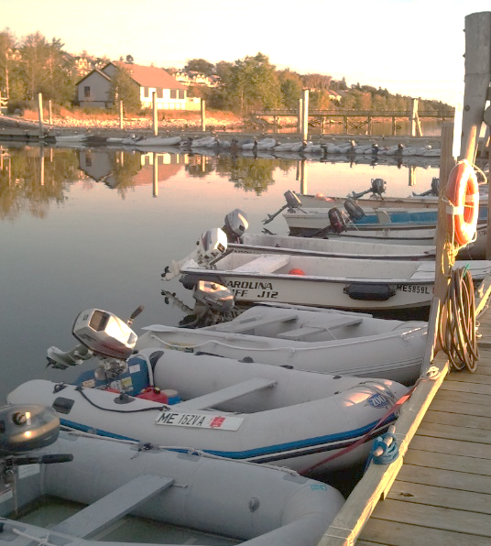
Inflatable Boats
15’ to 18’ lengths
15 to 45 lbs.
Materials
LightFab
Rubber coated
Drybag included
Quick setup
Synthetic fabrics do not give off dioxins
Most Popular Inflatable Models
Model | Length | Weight
Lighter Than Air | 10’ | 25 lbs.
Bobber | 12’ | 32 lbs.
HighLiner | 14’ | 26 lbs.

Slide 6
Kayaks
Award-winning!
15’ to 18’ lengths
15 to 45 lbs.
Materials
LightFab
Rubber coated
Drybag included
Quick setup
Most Popular Kayak Models
Model | Length | Weight
Two Paddle | 8’ | 25 lbs.
Island Rover | 13’ | 32 lbs.
Spindrifter | 9’ | 26 lbs.

Slide 7
The Reviews Are In!

