Slide 1
Adding Special Elements to a Document

Slide 2
Objectives
Create a table
Insert and delete table columns and rows
Format a table
Add clip art
Add footnotes and citations

Slide 3
Objectives
Insert a header or footer
Add borders and shading
Work with themes
Format a research paper

Slide 4
Creating a Table
A table is a grid of rows and columns
the intersection of a row and column is called a cell
cells can contain either text or graphics
When you create a table, you specify the number of rows and columns
you can also add and delete rows and columns as you modify a table

Slide 5
Creating a Table
You can use tabs to organize text into rows and columns, but working with tables can be easier
Working with tables you will encounter:
Contextual tabs, meaning they appear only when a particular type of object is selected
the symbol in each cell is an end-of-cell-mark
the marks to the right of each row are end-of-row-marks

Slide 6
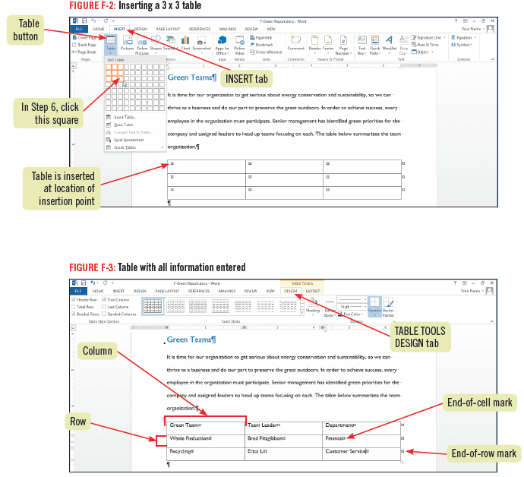
Creating a Table

Slide 7
Inserting and Deleting Table Columns and Rows
After you create a table, you might need to add more information or delete existing information
You can add rows to the top, bottom, or middle of a table; and you can add columns anywhere in a table
Use the commands on the TABLE TOOLS LAYOUT tab to add or delete columns and rows

Slide 8
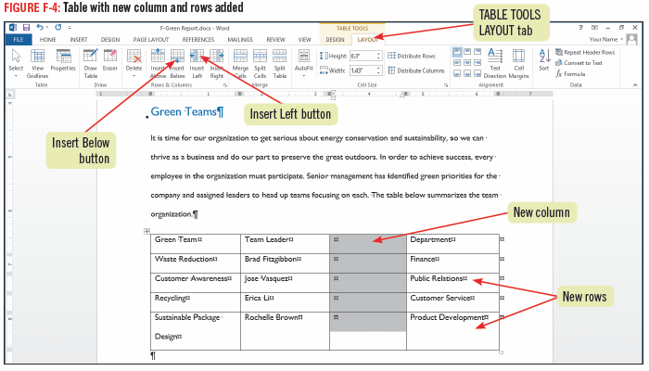
Inserting and Deleting Table Columns and Rows

Slide 9
Creating a Table with the Draw Table Button
You can use the Draw Table command to create a table
Click the INSERT tab, click the Table button, then click Draw Table
Drawing a table or cells into an existing table gives you more freedom to create tables with unequal columns, rows, or merged cells

Slide 10
Formatting a Table
After creating a table, it can be quickly formatted by applying a built-in table style, a predefined set of formatting attributes, including:
shading, fonts, border color
You can also format your table manually by choosing your own settings, but table styles are fast and professional looking
Once a table style is applied, you can further enhance and customize the table’s appearance using the Shading and Borders tools and adjusting column widths

Slide 11
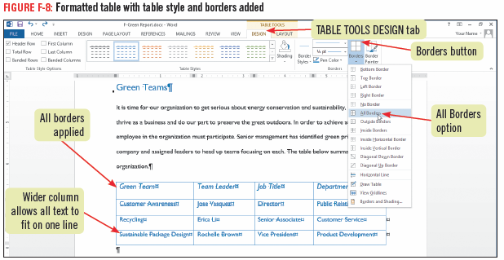
Formatting a Table

Slide 12
Adding Clip Art
You can insert graphics in your document to add visual interest or illustrate a point
There are hundreds of ready-made illustrations, called clip art
You can search for clip art on Office.com or perform a Bing image search
Search results appear as small pictures called thumbnails

Slide 13
Adding Clip Art
After a clip is inserted into a document, you can enhance it by applying picture styles, changing the way text wraps around it, moving it, or resizing it
images have square sizing handles in the corners and square sizing handles on the side when the image is selected

Slide 14
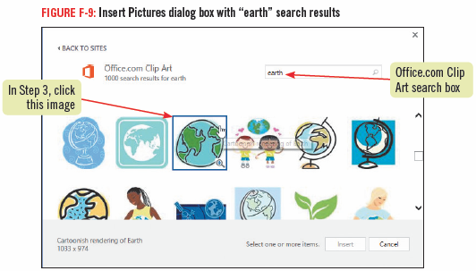
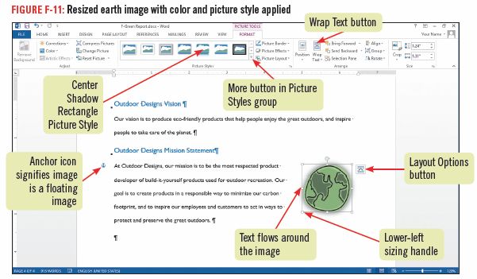
Adding Clip Art

Slide 15
Adding Footnotes and Citations
Documents may include quotes or paraphrased material from other sources which need to be given credit
A citation is a reference to a source which may include the author’s name and page number(s)
there are difference styles for using citations; MLA style is often used for research papers
citations that follow MLA guidelines appear in parentheses after a quote or paraphrase

Slide 16
Adding Footnotes and Citations
If a document contains citations, it must also include a bibliography, which is a listing of detailed source information for citations
The REFERENCES tab in Word contains tools to manage sources, insert citations, and add a bibliography
You can use the REFERENCES tab to add footnotes, a comment that appears at the bottom of a page
it consists of two linked parts, the reference mark in the body of the document and the corresponding note text

Slide 17
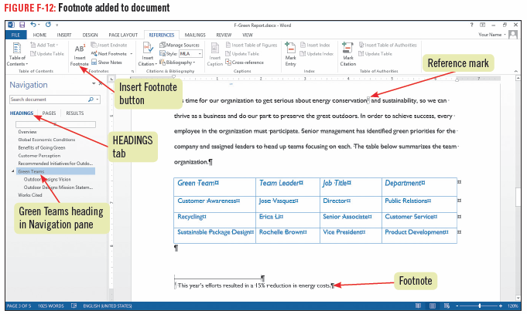
Adding Footnotes and Citations

Slide 18
Inserting a Header or Footer
You can easily add headers or footers to a document containing several pages
A header is text that appears in the top margin of each page
A footer is text that appears in the bottom margin of each page
Page numbers, the date, author’s name, or filename are the types of information that can be included
headers and footers can be formatted as regular text, and add graphics

Slide 19
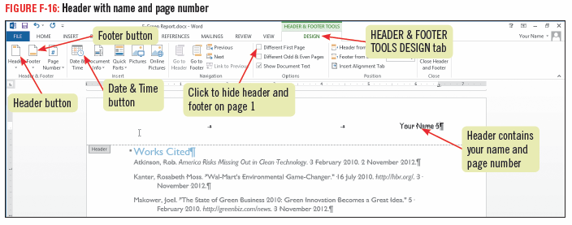
Inserting a Header or Footer

Slide 20
Adding Borders and Shading
To add visual interest, you can add borders and shading around text or entire pages
set a block of text apart from the rest of the page
apply background shading to words, paragraphs, graphics, or the entire page
Borders can be added at the top, bottom, left, or right edges of text or graphics
it is easiest to use the Shading and Borders buttons on the HOME tab to add to a document

Slide 21
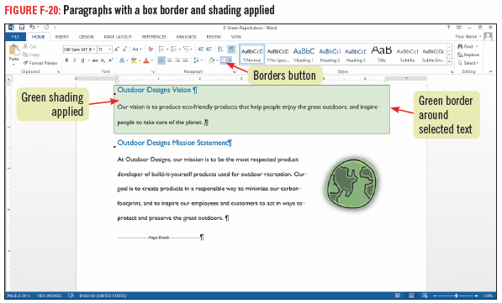
Adding Borders and Shading

Slide 22
Working with Themes
A theme is a coordinated set of colors fonts and effects that are applied consistently throughout a document providing a professional look
You can vary a theme’s fonts and color by applying different sets of theme font and colors
When a theme is applied it updates any styles that had been previously applied
All themes are available in Word, Excel, Access, PowerPoint and Outlook

Slide 23
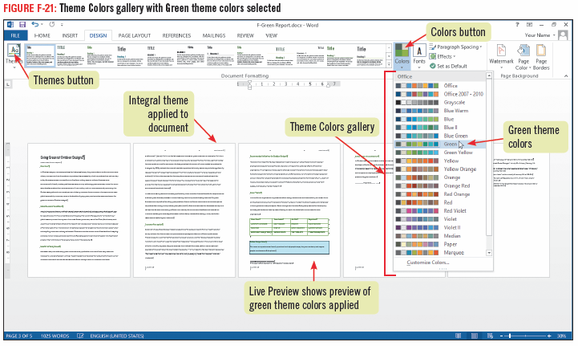
Working with Themes

Slide 24
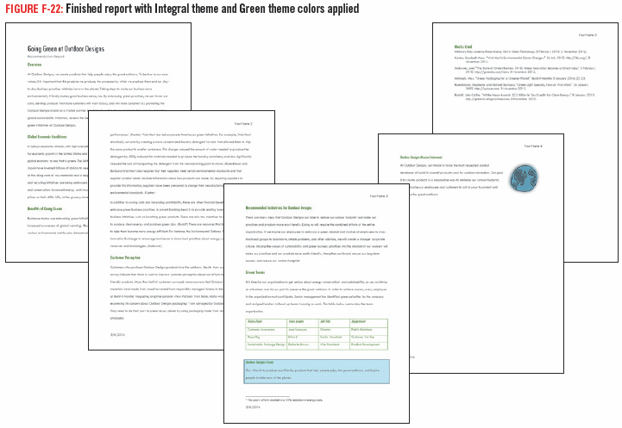
Working with Themes

Slide 25
Formatting a Research Paper
There are guidelines to follow when writing research papers
Modern Language Association (MLA) style is a popular standard for formatting academic research papers

Slide 26
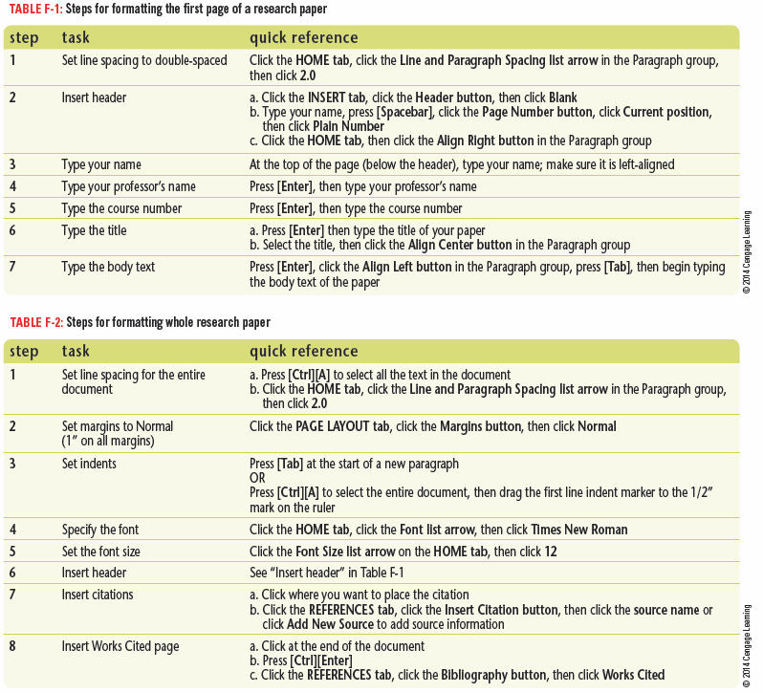
Formatting a Research Paper

Slide 27
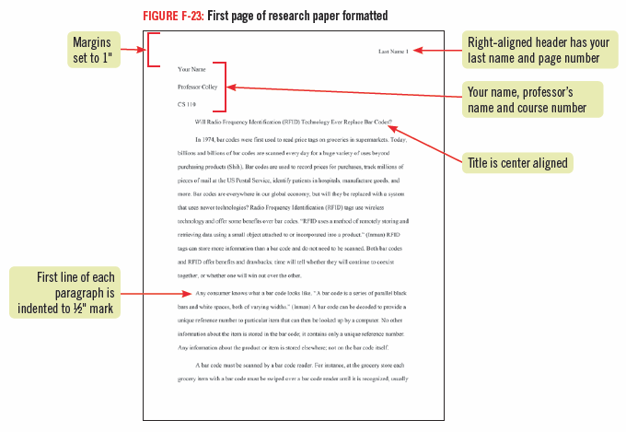
Formatting a Research Paper

Slide 28
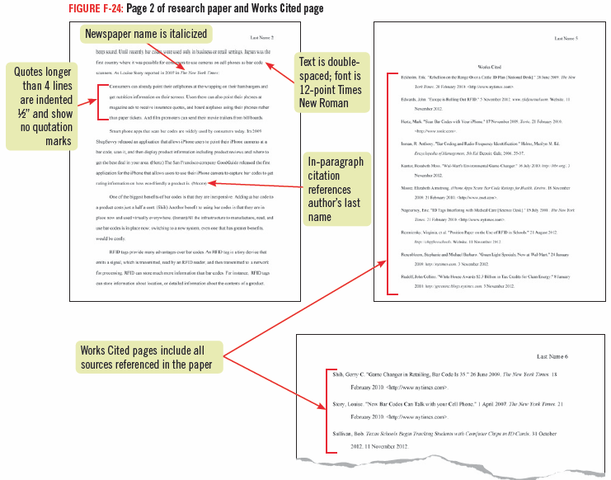
Formatting a Research Paper

