Slide 1
Creating a Document

Slide 2
Objectives
Create a new document from an existing file
Enter text in a document
Select and edit text
Copy text
Move text

Slide 3
Objectives
Find and replace text
Format text using the Mini toolbar
Check spelling and grammar
Preview and print a document

Slide 4
Creating a New Document from an Existing File
At times it is useful to create a new document that uses content from an existing document
Open the existing document and before making any changes you can use the Save As command to save a copy of the document
This keeps the original file intact in case you want to use it again
Using an existing document saves time and trouble of creating a new document from scratch

Slide 5
Creating a New Document from a Template
Certain types of documents are easily created using a template in Word 2013
a template is a file that contains predesigned formatting and text for common business documents
to create a document from a template, click the FILE tab, then click New to open the New screen in Backstage view, and then click the template you want

Slide 6
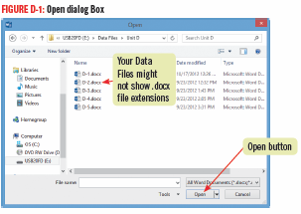
Creating a New Document from an Existing File

Slide 7
Entering Text in a Document
To add text to a document, click to position the insertion point, the blinking vertical line, where you want to insert text, and then start typing
Typing text is also called entering text
Before you start typing, check that you are in Print Layout view, which is the default view for entering and editing text
it is a good idea to turn on formatting marks to see the blank spaces and paragraph marks

Slide 8
Entering Text in a Document
As you type the words move down, or wrap, to the next line automatically when the insertion point reaches the right margin
While entering text, if you type “teh” the AutoCorrect feature will automatically make the correction to “The”
You can work with Styles, which are settings that control how text and paragraphs are formatted
each document has its own set of styles which can be easily changed

Slide 9
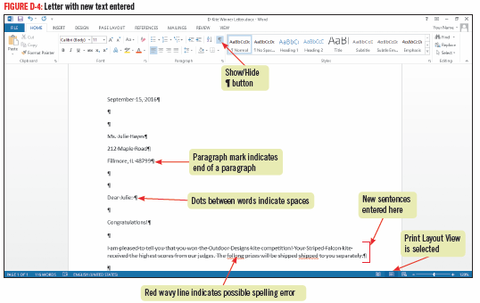
Entering Text in a Document

Slide 10
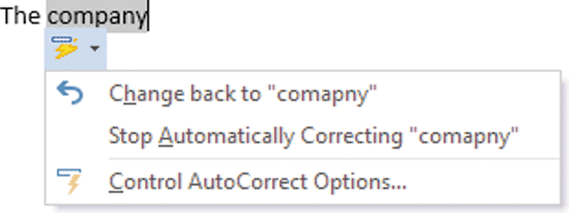
Using AutoCorrect
The AutoCorrect feature works automatically to catch and correct incorrect spelling of common words as you type them
You can change AutoCorrect settings in the AutoCorrect dialog box

Slide 11
Selecting and Editing Text
You can modify or edit text in many ways
click to the right of unwanted text, then press [Backspace]
click to the left of unwanted text, then press [Delete]
Select or highlight unwanted text, or paragraphs of text then type new text to replace it

Slide 12
Selecting and Editing Text
To be able to edit text you need to move the Insertion point around the document; you can use:
Point and click
using the keyboard
place the mouse pointer in the selection bar, area to the left of the left margin to select entire lines

Slide 13
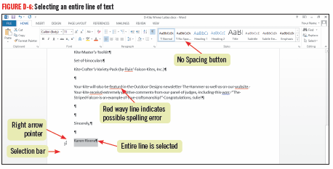
Selecting and Editing Text

Slide 14
Selecting and Editing Text

Slide 15
Copying Text
Copying leaves the text in the original location
Pasting moves a duplicate of it to a specified location
To copy and paste text, you first need to select the text to copy
The Copy command places a copy of the selected text on the Windows Clipboard, a temporary storage are in your computer’s memory
the Paste command inserts the copied text to a new location

Slide 16
Copying Text
If you need to copy multiple items, you can use the Office Clipboard, which works like the Windows Clipboard
stores up to 24 terms at a time and is available only in Office programs
To use the Office Clipboard, you need to open the Clipboard task pane
To use drag and drop; select the text to copy, press and hold [Ctrl] then use the mouse to drag a copy of the selected text to the new location
items do not get placed on the Windows or Office Clipboard

Slide 17
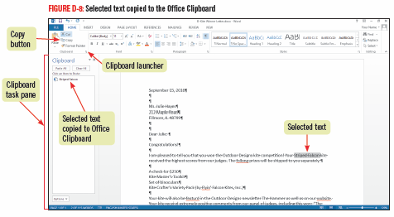
Copying Text

Slide 18
Moving Text
Moving text removes it from the original location and places it in a new specified location
You can move text from one location to another using these methods:
using the Cut command removes selected text and places it ion the Windows Clipboard
use the Paste button to place the cut text in another location
Selecting and dragging selected text to a new location
items will not be copied to the Windows or Office Clipboard

Slide 19
Activating the Office Clipboard
The Office Clipboard stores multiple items only if it active
Opening the Clipboard task pane automatically makes it active
If wanting to activate the Office Clipboard without showing the task pane, click Options to set it not to Collect Without Showing Office Clipboard
If the Office Clipboard is not active, you can only copy one item at a time using the Windows Clipboard

Slide 20
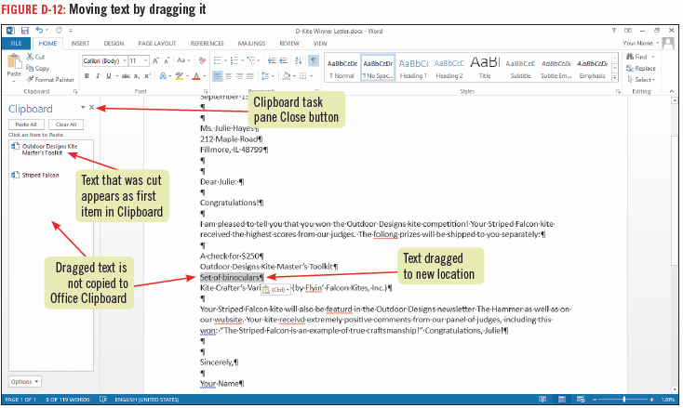
Moving Text

Slide 21
Finding and Replacing Text
The Replace command helps you quickly and easily substitute a new word or phrase for one or more occurrences
Use the Find and Replace dialog box to specify the text you want to find and the text with which you want to replace it
You can replace every occurrence of the text in one action, or you can review each occurrence and choose to replace it or keep the text

Slide 22
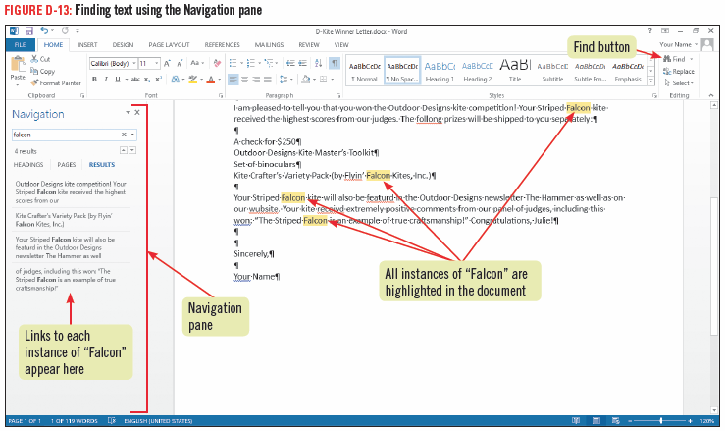
Finding and Replacing Text

Slide 23
Using the Navigation pane to Find Text
You can use the Navigation pane to quickly locate and highlight all instances of specified text
Use Find, type the text you want to find in the Search box
all instances of the text are highlighted in yellow in the document
the Navigation pane displays excerpts containing the text
click any excerpt in the Navigation pane to jump to the location of the instance of the text

Slide 24
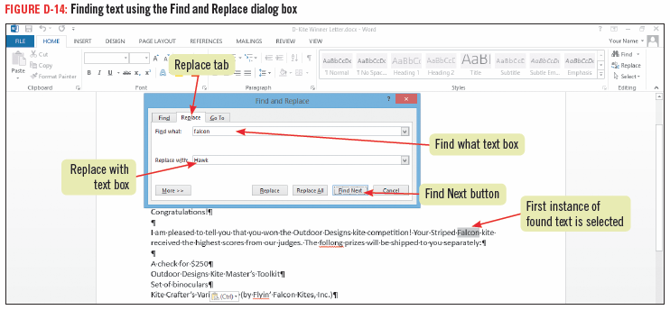
Using the Navigation pane to Find Text

Slide 25
Using Research Tools
As you create documents in Word, you might want to look up words or information
To add a dictionary, click the REVIEW tab, click the Define button in the Proofing group, choose the dictionary you want to install, then click Download
To access the built-in thesaurus, click Thesaurus in the Proofing group on the REVIEW tab

Slide 26
Formatting Text Using the Mini Toolbar
The Mini toolbar contains only the most common formatting commands
Use the Mini toolbar to make quick formatting changes to selected text
change the font (the design of a set of characters) such as Arial or Times New Roman
change the font style (bold, underline, italic)
change font size of selected text so that it is larger or smaller

Slide 27
Formatting Text Using the Mini Toolbar
You can format selected paragraphs as a bulleted list using the Mini toolbar
All of the Mini toolbar buttons are also available on the HOME tab

Slide 28
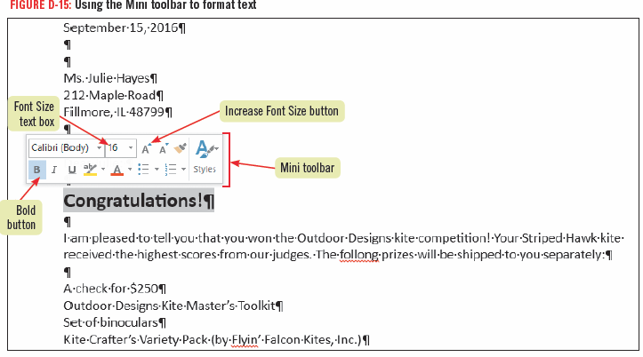
Formatting Text Using the Mini Toolbar

Slide 29
Checking Spelling and Grammar
Word provides tools to ensure your documents are free of errors
AutoCorrect feature corrects errors as you type (changes “teh” to “the”)
Word identifies possible misspellings with red wavy underlines and possible grammatical errors with green wavy underlines
the program identifies possible misspelled words by comparing each word to its built-in dictionary
you can open the Spelling and Grammar dialog box or right-click flagged misspelled words to identify and correct errors

Slide 30
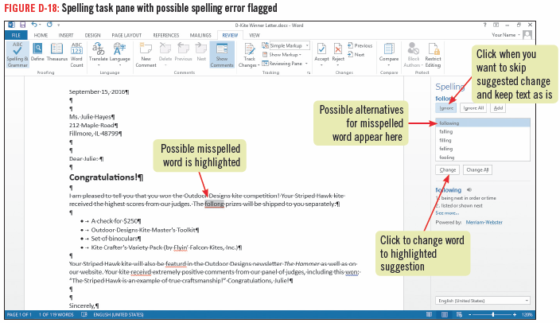
Checking Spelling and Grammar

Slide 31
Translating Documents into Other Languages
Word 2013 has the ability to translate any word in your document into more than 20 different languages
To translate an entire document from one language to another, on the REVIEW tab click the Translate button in the Language group, click Choose Translation Language, specifiy the Translate from and Translate to languages, then click OK

Slide 32
Previewing and Printing a Document
When you finish creating and editing a document, you can print it using the Print tab in Backstage view
The Print tab tools specify various print settings, printer selection, how many copies or specific pages to print
On the Print tab a preview of the document can be seen so that you can see exactly how it will look when printed
using Print Preview can save paper

Slide 33
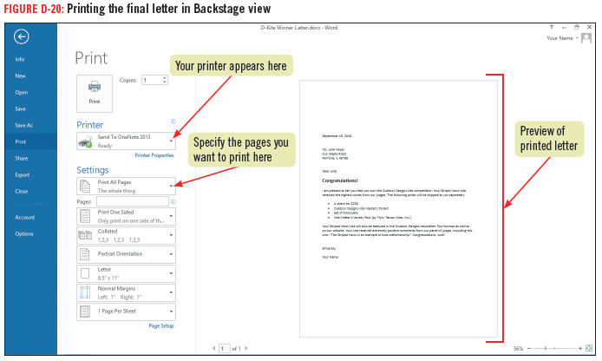
Previewing and Printing a Document

Slide 34
Previewing and Printing a Document

