Slide 1
Polishing and Running a Presentation

Slide 2
Objectives
Add pictures
Add sound
Add video
Set slide transitions and timing
Animate slide objects

Slide 3
Objectives
Use speaker notes and slide show commands
Print handouts and notes pages
Design effective presentations

Slide 4
Adding Pictures
In PowerPoint a picture might be a photograph, a shape you draw, a piece of clip art, or an illustration created using a graphics app
You can use features on the PICTURE TOOLS FORMAT tab to:
Crop, or cut off, portions of a picture
Remove the picture background
Cropping handles on each corner and each side let you reduce the size of a picture

Slide 5
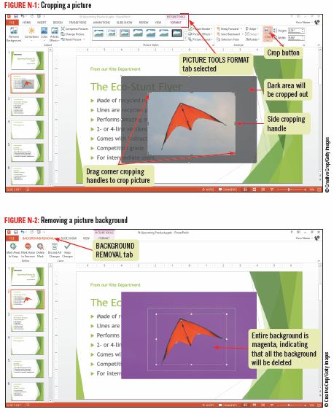
Adding Pictures

Slide 6
Adding Sound
Adding sound can enhance your presentations
You can add sound clips, also called audio files, from online collections such as:
Office.com
Files you obtain from other sources
Sounds you record yourself
Like pictures, sounds you add to your presentation are objects and can be moved and modified

Slide 7
Adding Sound
You can specify:
Whether or not to show the sound file icon on a slide
How the icon will appear
When you want the sound to play

Slide 8
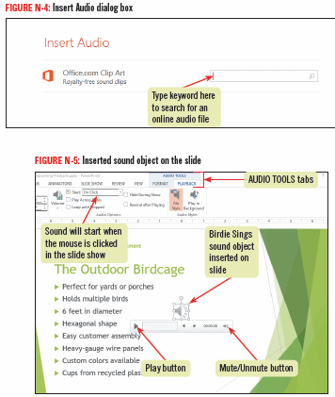
Adding Sound

Slide 9
Adjusting Sound Playback during a Slide Show
You can change the way a sound plays back during the slide show by using commands on the AUDIO TOOLS PLAYBACK tab
You can use the tools in the Editing group to trim the audio clip, have the sound fade in and out, and control when and how the audio clip plays

Slide 10
Adding Video
Adding video to a presentation can help your viewers remember your message
You can insert a video file from an online resource or from a collection you have saved on your computer
You can use features on the VIDEO TOOLS PLAYBACK tab to adjust how and when the video plays during the slide show

Slide 11
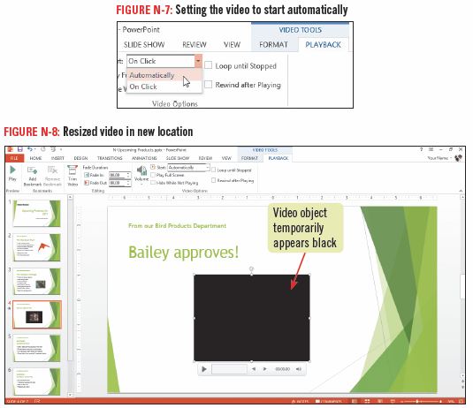
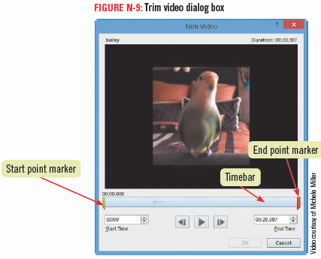
Adding Video

Slide 12
Formatting Sound and Video Objects
You can change the way a sound or video object appears on a slide
Adjust its color or brightness
Apply a style such as a frame, shape, border, or effect
Crop and rotate the object
To copy formatting from one object to another, click the object whose formatting you want to copy, click the Format Painter button on the HOM tab, then click the second object

Slide 13
Setting Slide Timing and Transitions
There are many times when you want to run a presentation automatically, not manually
You may also want to customize how slides appear in a slide show

Slide 14
Setting Slide Timing and Transitions
You can set slide timings and transitions
a transition is a special effect that determines how a slide appears as it enters and leaves the screen
a timing is the number of seconds a slide remains on the screen before advancing to the next one
you can adjust settings for individual slide or apply one setting to multiple slides

Slide 15
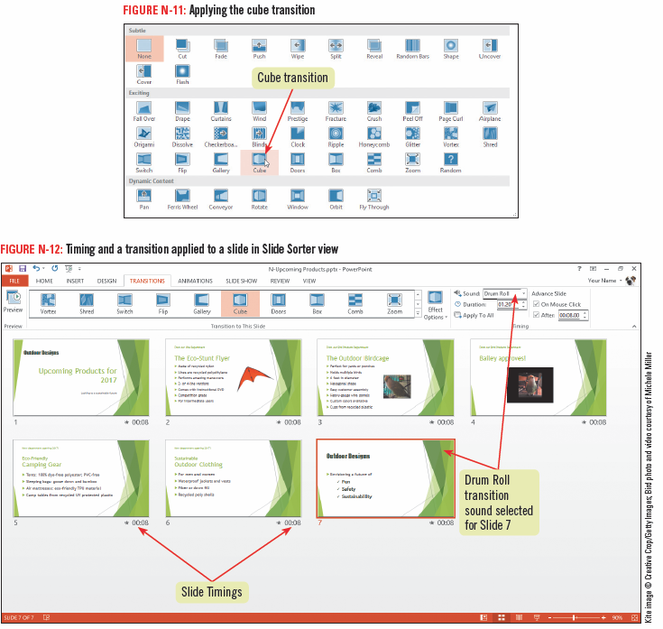
Setting Slide Timing and Transitions

Slide 16
Using Slide Masters
Used to make a design change to all the slides in your presentation
A slide master contains the layouts, design elements, and other formatting for a presentation
Every slide is based on a master
A slide master has a number of supporting layouts
To modify a slide master, click the VIEW tab, then click the Slide Master button

Slide 17
Animating Slide Objects
You can add interest to text and graphics by applying animations
Animation effects are movements or changes in appearance that you can apply to any text placeholder or graphic

Slide 18
Animating Slide Objects
Use animations to control how any object enters, exits, or becomes emphasized on a slide during a slide show
Entrance animations
Emphasis animations
Exit animations
You can use the Animation Painter to apply settings to other objects

Slide 19
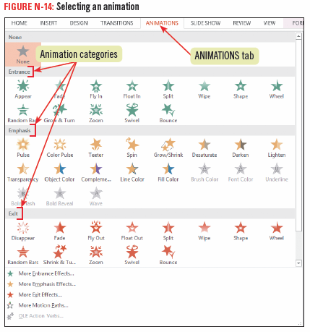
Animating Slide Objects

Slide 20
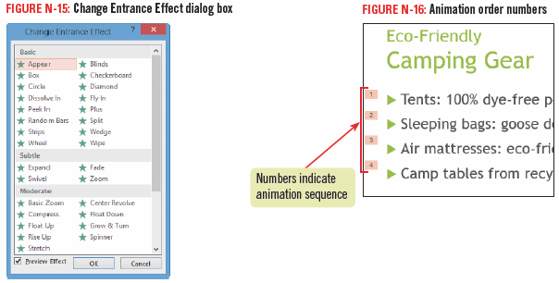
Animating Slide Objects

Slide 21
Adding Animations using the Animation Pane
You can add more than one animation to an object and control when each animation occurs using the Animation pane
Select an object to which you’ve applied one animation, click the Add Animation button, and then click the Animation Pane button

Slide 22
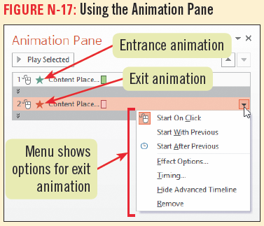
Adding Animations using the Animation Pane

Slide 23
Using Speaker Notes and Slide Show Commands
You can add speaker notes to any slide using the Notes pane
You can view your slides and notes in Notes Page view
You can run your presentation in presenter view

Slide 24
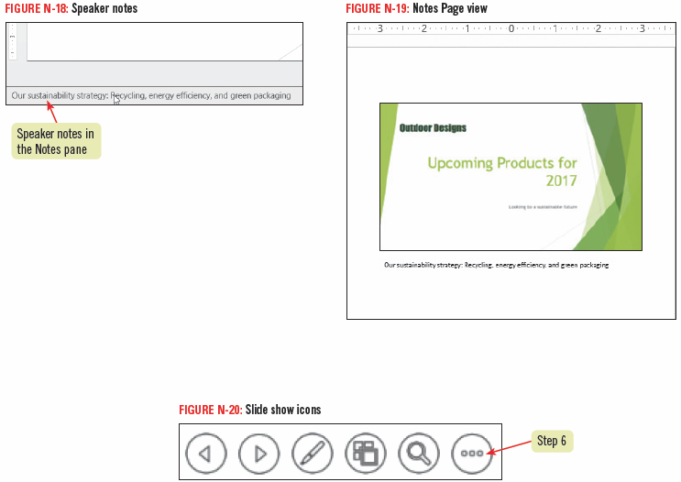
Using Speaker Notes and Slide Show Commands

Slide 25
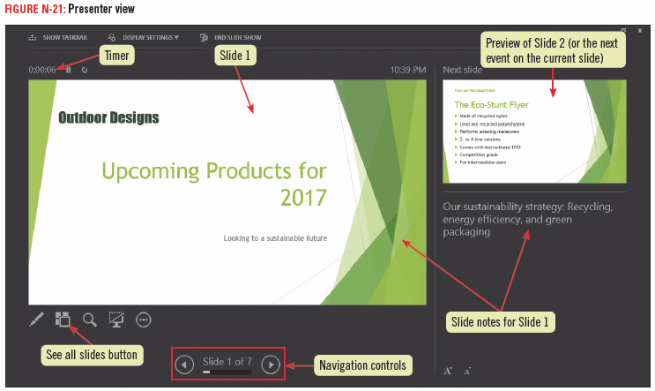
Using Speaker Notes and Slide Show Commands

Slide 26
Printing Handouts and Notes Pages
When you give a presentation, you may also want to give a printed copy to your audience so they can use it to take notes
You can print a handouts, which prints one or more slides per page, and you can include blank lines for audience members to use for notes
You can print Notes pages, which contain a thumbnail of each slide plus any speaker notes you added in the Notes pane

Slide 27
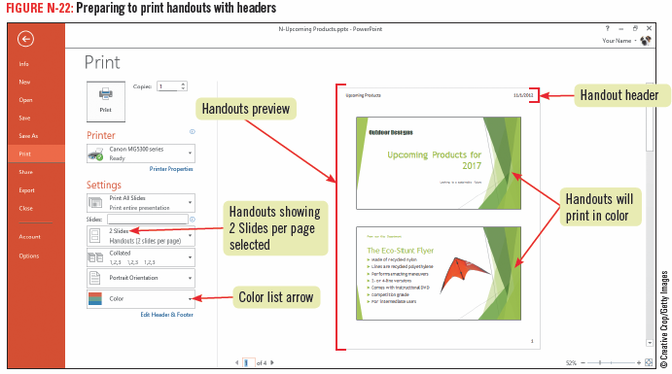
Printing Handouts and Notes Pages

Slide 28
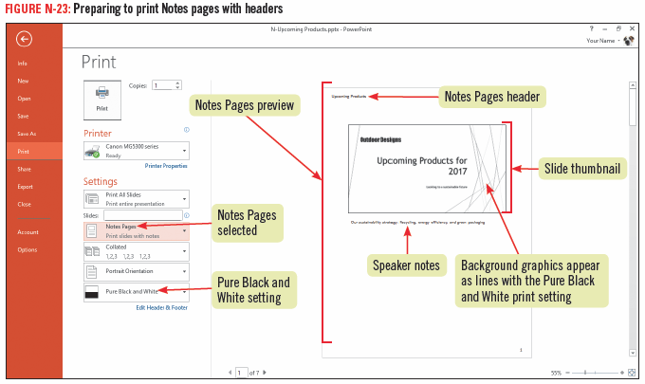
Printing Handouts and Notes Pages

Slide 29
Printing Presentation Slides
You might want to print each of your presentation slides on a separate page, adding header and footer information
Click the FILE tab, click print, and then set the desired options
To add a header and footer, click Edit Header & Footer

Slide 30
Designing Effective Presentations
Make sure you communicate your presentation goals to the audience
Text and graphics should be appropriate in both content and appearance

Slide 31
Designing Effective Presentations
As you create a presentation, consider the following:
Content
Design
Text
serif font
sans serif font
Graphics
Transitions and animations

Slide 32
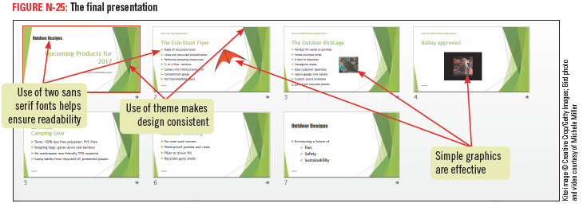
Designing Effective Presentations

Slide 33
Sharing a Presentation
You can share your presentations with others in several different ways
Email
Web or network location (SkyDrive)
Sharing your presentation online creates a link others can use to watch your slide show using their web browsers
Record a video of your presentation

