Slide 1
Getting Started with Microsoft Office 2013

Slide 2
Objectives
Understand Office Professional Plus 2013
Start an Office app
Identify common screen elements in an Office app
Use the Ribbon and zoom controls

Slide 3
Objectives
Use the Quick Access toolbar
Save a file
Get Help
Exit an Office app

Slide 4
Understand Office Professional Plus 2013
Microsoft Office 2013 is a collection (or suite) of programs or apps that you can use to produce a wide variety of documents
Office 2013 Professional Plus includes Word, Excel, Access, PowerPoint, Outlook, Publisher, and OneNote
Office 2013 is designed for the cloud, which means you can access the Office work you create from a variety of devices, as long as they are connected to the Internet

Slide 5
Understand Office Professional Plus 2013
Office 2010 Professional Edition comes with a variety of programs and tools you can use
A powerful benefit of Office 2010 is the ability to save your files to SkyDrive as well as the Office Web Apps:
a scaled down version of Word, Excel, and PowerPoint that run over the internet
promotes a collaborative working environment even from different locations

Slide 6
Understand Office Professional Plus 2013
Microsoft Office 2013 Professional Plus contains the following programs:
Microsoft Word - word processing
Microsoft Excel - spreadsheet
Microsoft Access – database management
Microsoft PowerPoint – presentation graphics
Microsoft Outlook – information manager
Microsoft Publisher – desktop publishing
Microsoft OneNote – capture and store info
Examples of applications on the next 2 slides

Slide 7
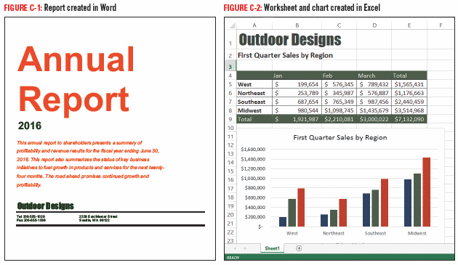
Understand Office Professional Plus 2013

Slide 8
Understand Office Professional Plus 2013

Slide 9
Starting an Office App
You can launch, or start the Office app many ways, such as using the Start screen (Windows 8) or the Start menu (Windows 7)
The start screen is a landing page that appears when you first start an Office app
The left side of this screen displays recent files you have opened
The right side displays images depicting different templates you can use to create different types of documents

Slide 10
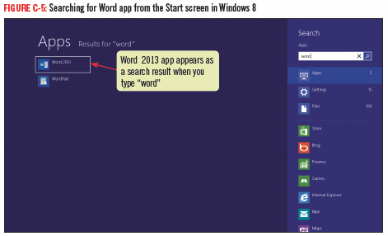
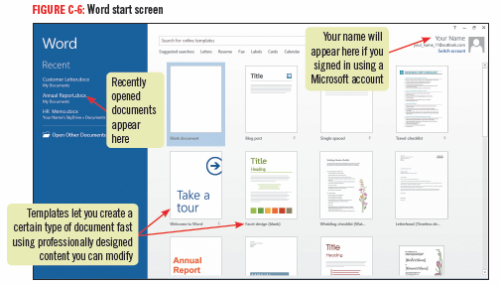
Starting an Office App

Slide 11
Identifying Common Screen Elements in an Office App
A user interface is the collection of buttons and tools you use to interact with a software program
Title bar – located at the top of the app window containing the name of the document
Ribbon – contains commands in the form of buttons
Command is an instruction given to the computer
Tabs – contain different sets of commands
each tab is organized into groups of related commands

Slide 12
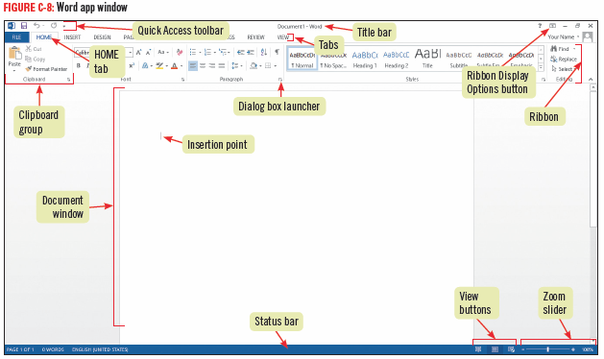
Identifying Common Screen Elements in an Office App

Slide 13
Using the Ribbon and Zoom Controls
In all Office programs, you use the Ribbon to initiate commands
some commands are the same across Office programs and some vary depending on the application
The VIEW tab has similar commands you can use to:
switch to predefined view
adjust the magnification level
Many Office apps also contain a Zoom slider on the status bar to adjust the magnification level as well as View shortcut buttons

Slide 14
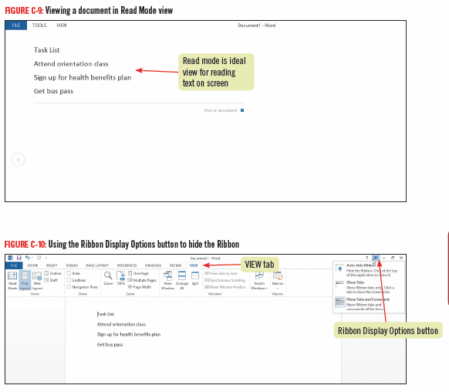
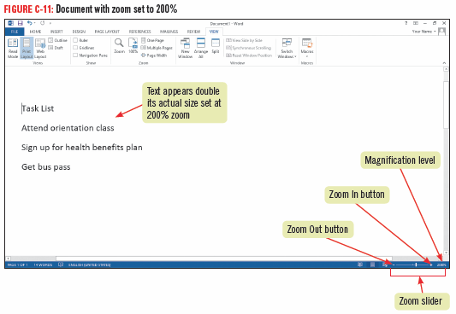
Using the Ribbon and Zoom Controls

Slide 15
Using the Quick Access Toolbar
The buttons on the Quick Access toolbar, located just above the Ribbon on the left side, are available anytime except when the FILE tab is active
Default buttons on the Quick Access Toolbar include:
Save a file
Undo your last action
Redo the last action you undid
Buttons you frequently use can be added using the Customize Quick Access Toolbar menu

Slide 16
Using the Quick Access Toolbar
To add buttons to the Quick Access toolbar:
click Customize Quick Access Toolbar button and then select which commands you use frequently to add to the Quick Access Toolbar
You can also remove any button from the Quick Access toolbar

Slide 17
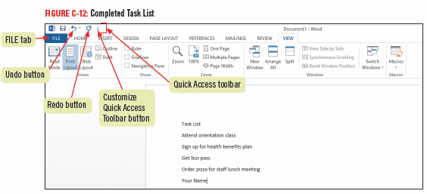
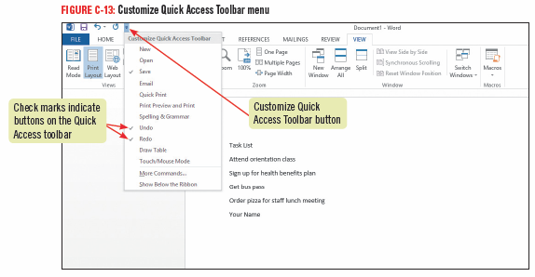
Using the Quick Access Toolbar

Slide 18
Saving a File
To keep a document permanently it needs to be saved to a specific place, such as in a folder on your SkyDrive, your computer’s hard drive, removable flash drive, or drive located on a network
Use the Save As to save a file for the first time
you can access the Save As command in Backstage view, which provides commands and tools to help you work with files
Access Backstage view by clicking the FILE tab on the Ribbon

Slide 19
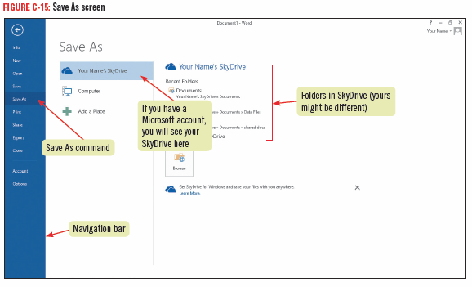
Using the Quick Access Toolbar

Slide 20
SkyDrive and Microsoft Office Web Apps
If you are signed into your Microsoft account, you can easily save your files to SkyDrive
Available as an app on your smartphone
You can make edits to documents on SkyDrive using Office Web Apps
You can use Office Web Apps on any computer
You can sign up for a free Microsoft account at http://skydrive.live.com

Slide 21
Getting Help
Help is context-sensitive in that it displays topics and instructions geared to the specific task
The Help system is integrated with the Microsoft Office Online Web site
When pointing to a command on any tab, a ScreenTip opens displaying a description
many ScreenTips also direct you to press [F1] for additional information
If using the Search online help text box in Help it searches for a keyword, which is searchable word that is contained in Help

Slide 22
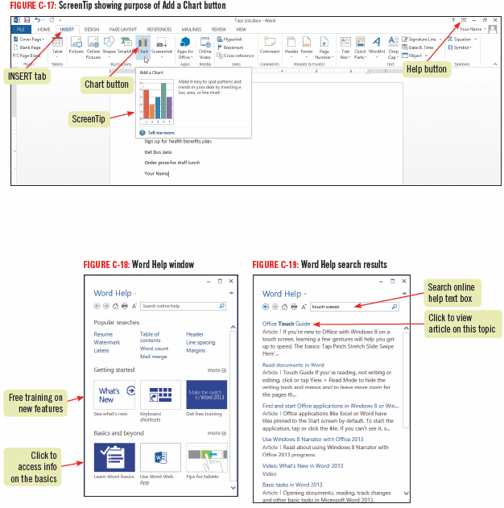
Getting Help

Slide 23
Exiting an Office App
When you complete all the work you want to accomplish in an Office app session, you can save and close your document
You can quickly open it by clicking the file name in the Recent section of the app’s start screen
When you are finished working in an Office app, you click the Close button on the right end of the title bar to exit the app

Slide 24
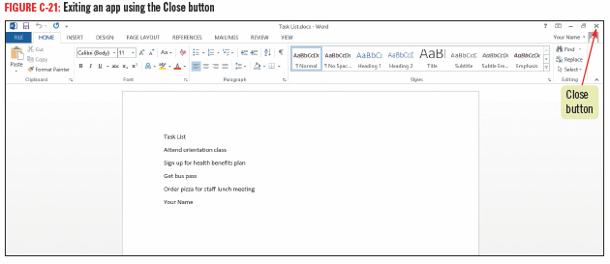
Exiting an Office App

Slide 25
Sharing your saved documents
You can email your saved documents easily from within Office using the Share page on the FILE tab
Click the FILE tab and then click Share. On the Share page, click Email, then click Send as Attachment
The Share page also lets you fax a document or email a copy of a document in PDF or XPS formats

