Slide 1
Integrating Office 2013 Programs

Slide 2
Objectives
Insert an Excel chart onto a PowerPoint slide
Insert PowerPoint slides from a Word document
Insert screen clips into a Word document
Insert text from a Word file into an open document

Slide 3
Objectives
Link an Excel chart to a Word document
Update a linked Excel chart in a Word document
Insert merged fields into a Word document
Perform a mail merge

Slide 4
Inserting an Excel Chart into a PowerPoint Slide
When you want to show a simple chart to your audience in PowerPoint, you can enter the data and select a chart type using an Excel spreadsheet within PowerPoint
When you create a chart in PowerPoint, you embed into the presentation
Once the chart is created, you can edit and format it using the CHART TOOLS DESIGN and CHART TOOLS FORMAT tabs in PowerPoint

Slide 5
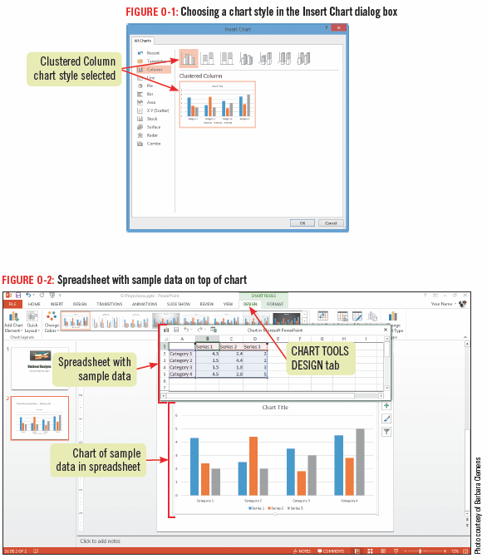
Inserting an Excel Chart into a PowerPoint Slide

Slide 6
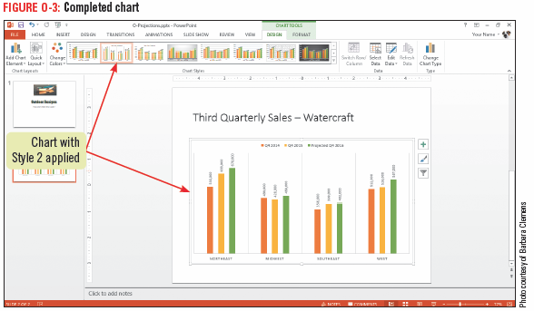
Inserting an Excel Chart into a PowerPoint Slide

Slide 7
Inserting PowerPoint Slides from a Word Document
You an use an outline that you have created in Word, as a starting point for a new PowerPoint presentation
The Word Outline view makes it easy to see how a document is organized
When you insert a Word outline into PowerPoint, lines that are formatted as Level 1 in the outline appear as slide titles, and lower-level text appears as bulleted text

Slide 8
Using Outlines in Word and PowerPoint
If you want to create an outline in Word that you can use as the basis for a PowerPoint presentation, t is best to use Word outline levels in your text
The heading tags in Word determine the structure of the outline when it is imported into PowerPoint
You can also save a PowerPoint presentation in outline format and then open it in Word

Slide 9
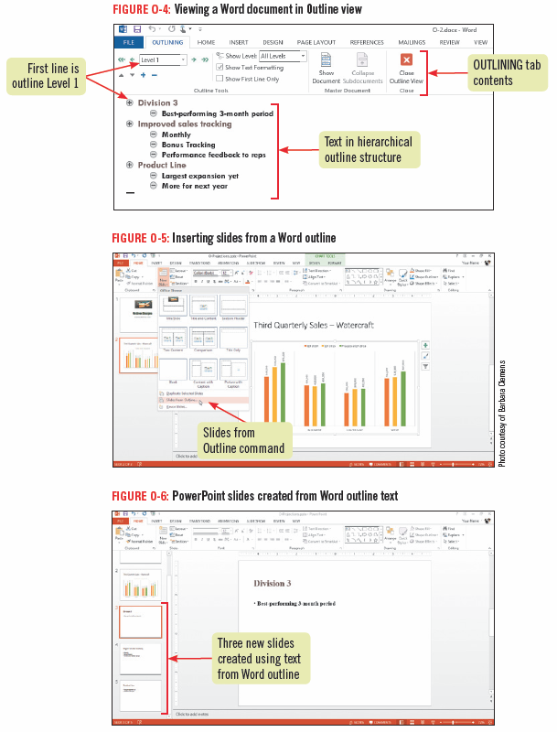
Inserting PowerPoint Slides from a Word Document

Slide 10
Inserting Screen Clips into a Word Document
When you need to place an image from another open document into a PowerPoint presentation or Word document, you can use the PowerPoint Screenshot feature
You can take a screenshot of an entire window or part of a window

Slide 11
Inserting Screen Clips into a Word Document

Slide 12
Inserting Screen Clips into a Word Document

Slide 13
Inserting Text from a Word File into an Open Document
Used when you want to combine two files into one, or insert another document into the current document
Although you can easily copy and paste information between two or more open documents, it is sometimes easier to insert the contents from a file without having to open it first

Slide 14
Placing an Access Table in a Word Document
You can insert an Access table into a Word document by various methods
copy the entire table or individual records and paste them into a Word document
use the Export feature in Access to export objects, such as a table, query, report, or form
Access always exports to a new Rich Text Format (RTF) file, you cannot export to an open Word document
the object in Word is not linked to Access and any modifications you make to an exported table in Word affect only the Word document

Slide 15
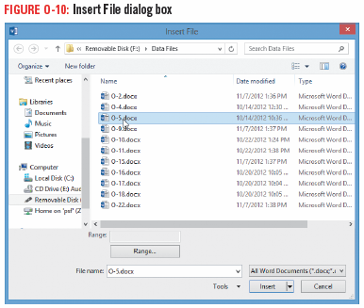
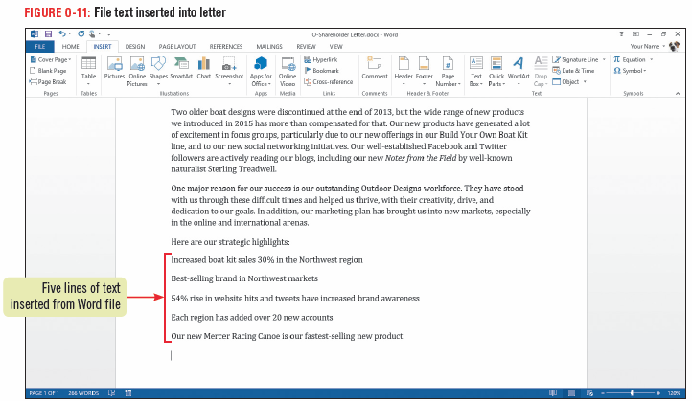
Inserting Text from a Word File into an Open Document

Slide 16
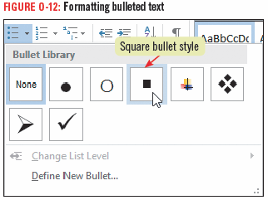
Inserting Text from a Word File into an Open Document

Slide 17
Linking Excel Data to a Word Document
Linking data shares updated information between files and programs
A link displays information from a source file, containing the data, and the destination file, the location to which the data is copied or moved
In a Word document, linked data looks just like inserted or embedded data
Linked data can be edited in the native program just by double-clicking the data

Slide 18
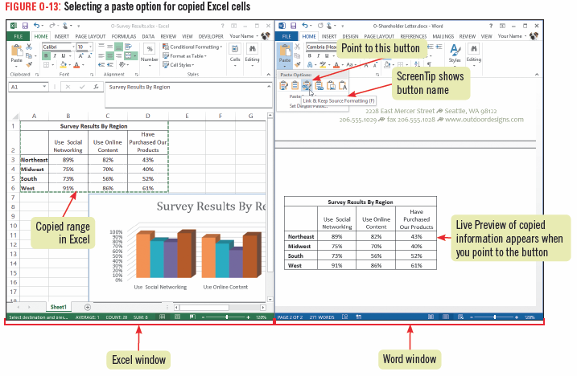
Linking Excel Data to a Word Document

Slide 19
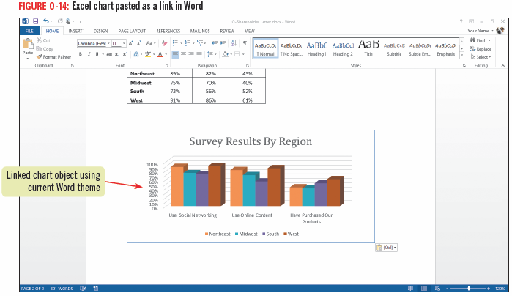
Linking Excel Data to a Word Document

Slide 20
Updating a Linked Excel Chart in a Word Document
When you update the source file, every linked object automatically updates
You can also update a linked object manually be right-clicking it and clicking Update Link or be selecting the linked object and press [F9] which updates links in any Office application

Slide 21
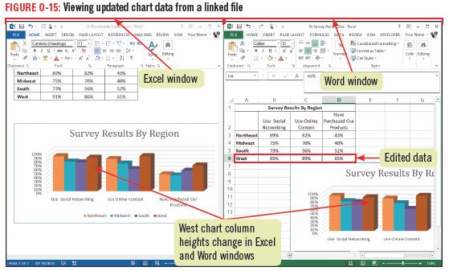
Updating a Linked Excel Chart in a Word Document

Slide 22
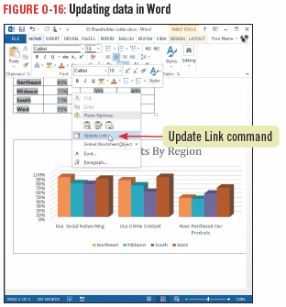
Updating a Linked Excel Chart in a Word Document

Slide 23
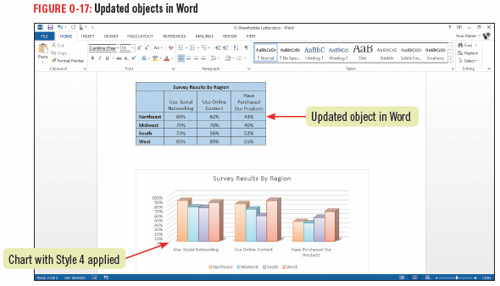
Updating a Linked Excel Chart in a Word Document

Slide 24
Inserting Merge Fields into a Word Document
A form letter is a document that contains standard body text and a custom heading containing the name and address for one of many recipients
The letter, or main document, is usually created in Word
The data source is usually a compiled in a table, a worksheet, or a database such as Access

Slide 25
Inserting Merge Fields into a Word Document
From the main document and the data source a third file, a merged document is created, called a mail merge
Before performing a mail merge, you add merge fields to the main document, which are placeholders to indicate where the custom information from the data source should appear

Slide 26
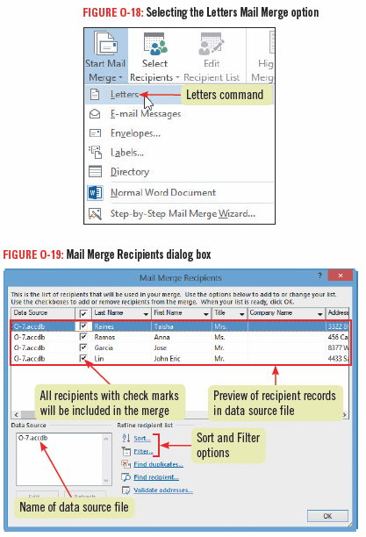
Inserting Merge Fields into a Word Document

Slide 27
Inserting Merge Fields into a Word Document

Slide 28
Performing a Mail Merge
After setting up a main document, specifying a data source, and inserting merge fields, you are ready to create your merged documents
You can preview the mail merge to ensure that all the information displays properly in the final document

Slide 29
Using Mail Merge to Send Personalized Email Messages
Using mail merge to create the email message enable you to personalize messages ensuring that only the recipient’s email address appears in the To: text box in the email message
The steps for creating an email mail merge are basically the same as for a letter mail merge

Slide 30
Performing a Mail Merge

Slide 31
Performing a Mail Merge

Slide 32
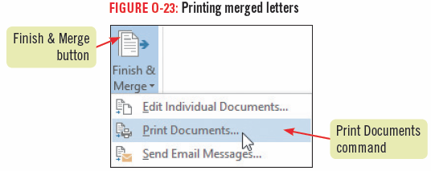
Performing a Mail Merge

