Slide 1
Creating Database Reports

Slide 2
Objectives
Create a report using the Report Wizard
View a report
Modify a report
Add a field to a report

Slide 3
Objectives
Apply conditional formatting to a report
Add summary information to a report
Create mailing labels

Slide 4
Creating a Report Using the Report Wizard
A report is a summary of database information designed specifically for printing
Report data can be from one database object or from multiple database objects
One way to create a report is by using the Report Wizard, which automatically create a report based on setting that you specify

Slide 5
Creating a Report Using the Report Wizard
Reports can be saved as objects in a database
Reports consist of sections that contain specific information
Choose the record source(s) to select the database object(s) from which a report gets its data
Use grouping to organize a report by field or field values

Slide 6
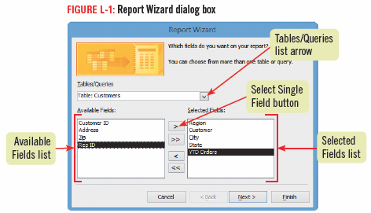
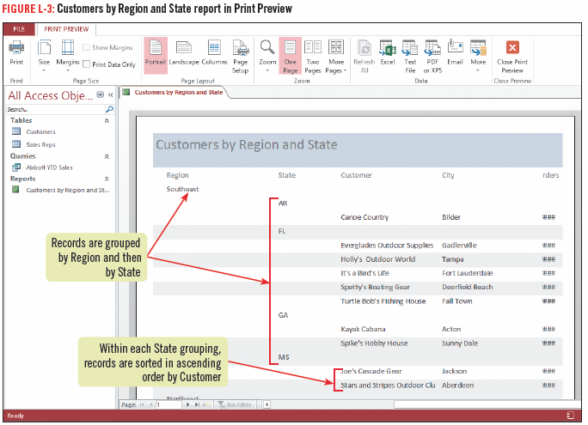
Creating a Report Using the Report Wizard

Slide 7
Viewing a Report
Access offers several ways to view a report
Print Preview-see exactly how the report will look when printed
Report View-looks similar to Print Preview, it displays the report in continuous flow without page break
Design View-includes many tools for modifying a report, but shows only the structure of the report not the included data
Layout View-does not include as many modification tools as Design view, but it shows you report data

Slide 8
Viewing a Report

Slide 9
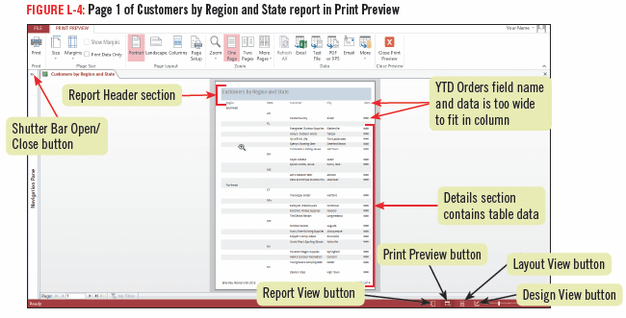
Viewing a Report

Slide 10
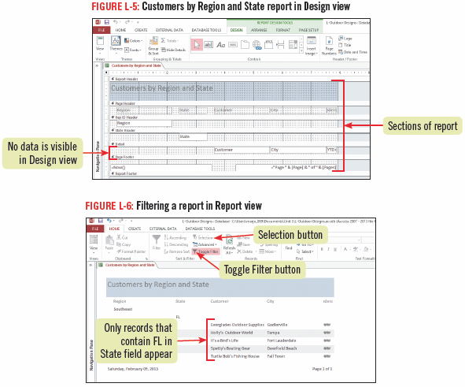
Viewing a Report

Slide 11
Modifying a Report
Reports are commonly modified to improve it’s appearance
You can use Layout view to resize, move, and delete columns

Slide 12
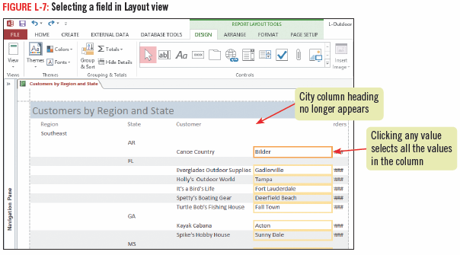
Modifying a Report

Slide 13
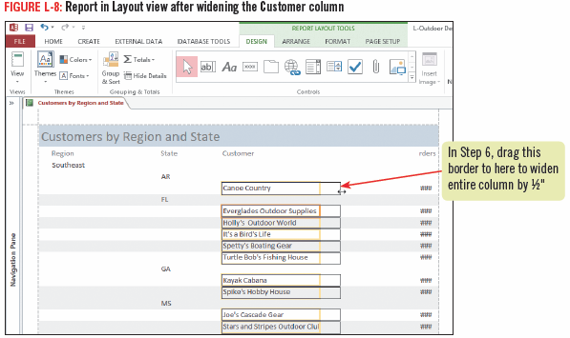
Modifying a Report

Slide 14
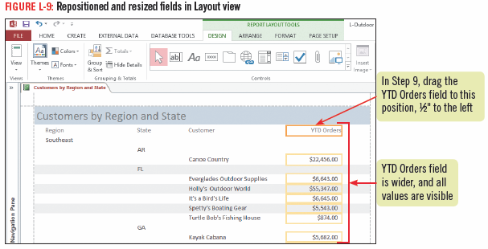
Modifying a Report

Slide 15
Adding a Field to a Report
You can use Layout view to add a field to a report
open the Field List, then double-click the desired field
Fields are added to the left side of a report
adjustments might need to be made to the other columns to place the new field where needed

Slide 16
Adding a Field to a Report
A field is composed of two parts: the field label, and its associated control
A control is an object that displays information in a report
Different controls are used for each data type
When you add a field to a report, the field label is automatically added to the header section, and the control is added to either the Group Header or the Detail section

Slide 17
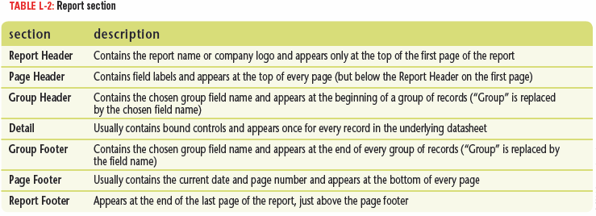
Adding a Field to a Report

Slide 18
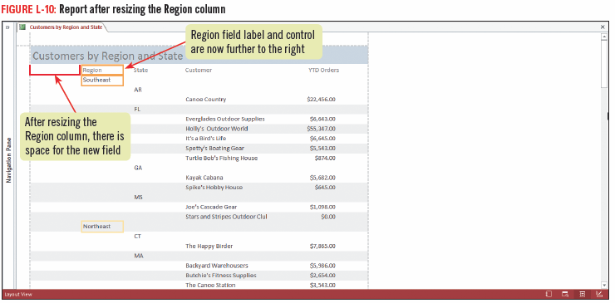
Adding a Field to a Report

Slide 19
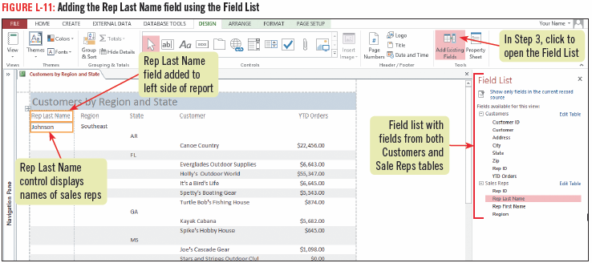
Adding a Field to a Report

Slide 20
Applying Conditional Formatting to a Report
As in an Excel worksheet, you can apply conditional formatting in an Access report to highlight key information
Conditional formatting is a way to draw attention to information that meets specific
You access the Conditional Formatting Rules Manager dialog box from the REPORT LAYOUT TOOLS FORMAT tab in Layout view

Slide 21
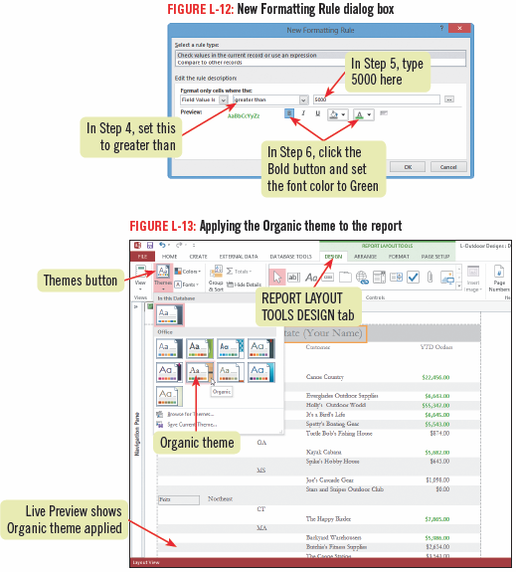
Applying Conditional Formatting to a Report

Slide 22
Adding Summary Information to a Report
Summary information in a report displays statistics about one or more fields in a database
Summaries can include statistics for sum, average, count, minimum and maximum in any numeric field
There are five summary calculations you can use in your database reports
You can add summary information while creating the report with the Report Wizard

Slide 23
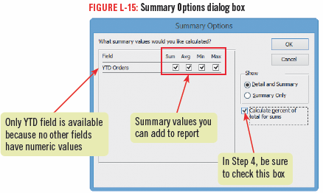
Adding Summary Information to a Report

Slide 24
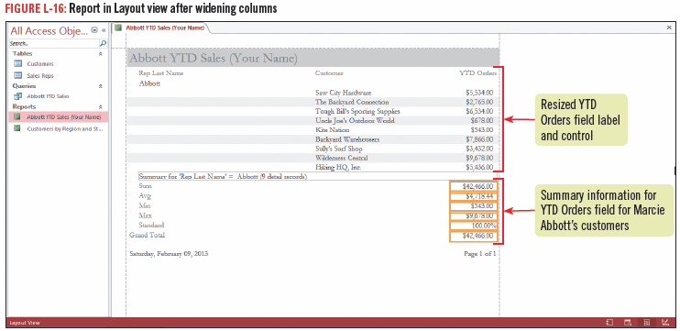
Adding Summary Information to a Report

Slide 25
Adding Summary Information to a Report

Slide 26
Creating Mailing Labels
You do not have to print all reports
You can use the data in a database to create other forms of printed output, such as labels or envelopes
Use the Label Wizard to create labels containing data from any fields in the database
Labels can be based on queries or tables

Slide 27
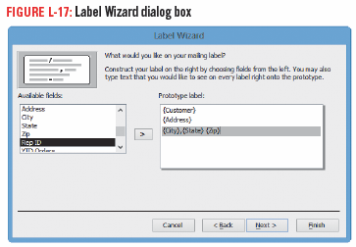
Creating Mailing Labels

Slide 28
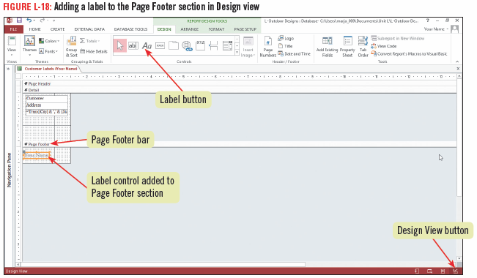
Creating Mailing Labels

Slide 29
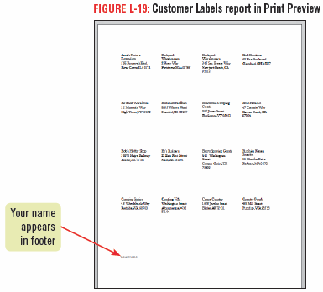
Creating Mailing Labels

