Slide 1
Working with Charts

Slide 2
Objectives
Understand and plan a chart
Create a chart
Move and resize charts and chart objects
Apply chart layouts and styles

Slide 3
Objectives
Customize chart elements
Enhance a chart
Create a pie chart
Create sparklines

Slide 4
Understanding and Planning a Chart
To create a chart you need to review some basic concepts
Understand the different parts of a chart
Horizontal axis (x-axis); horizontal line at the base of the chart displaying categories
Vertical axis (y-axis); vertical line at the left edge of the chart provides values
Axis titles; identify the values on each axis
Data series; sequence of related numbers that shows a trend
Data marker; single chart symbol that represents one value in a data series

Slide 5
Understanding and Planning a Chart
Legend; identifies what each data series represents
Gridlines; vertical and horizontal lines that help identify the value for each data series
Plot area; part of the chart contained within the horizontal and vertical axes
Chart area; entire chart and all the chart elements
Identify the purpose of the data and choose an appropriate chart type
Design the worksheet so that Excel creates the chart you want

Slide 6
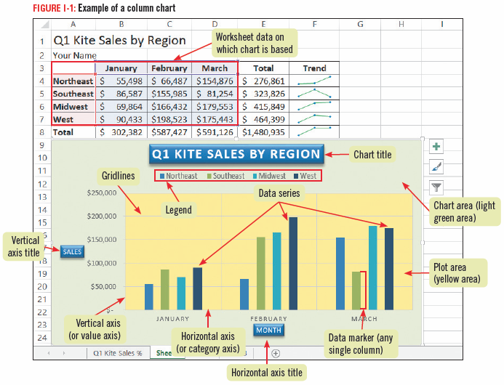
Understanding and Planning a Chart

Slide 7
Understanding and Planning a Chart

Slide 8
Creating a Chart
You can create Excel charts from your worksheet data
Select the cells containing data you want to chart
Click the Recommended Charts button on the INSERT tab to choose from a selection of chart types
Changes to the worksheet data are automatically reflected in the chart
You can change the chart type to what will best illustrate the data

Slide 9
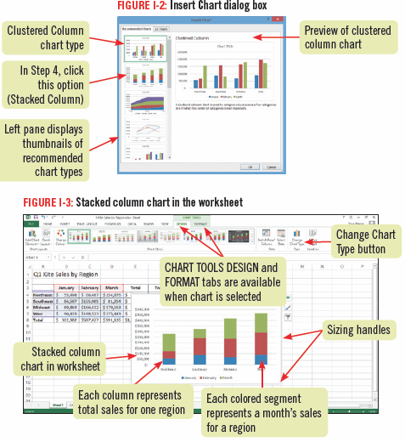
Creating a Chart

Slide 10
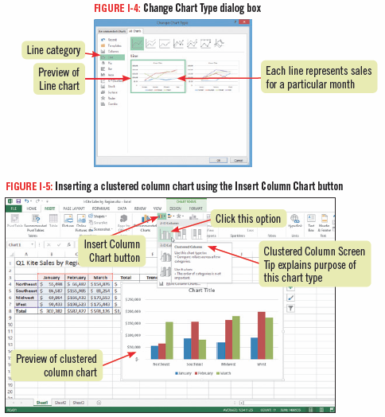
Creating a Chart

Slide 11
Moving and Resizing a Chart and Chart Elements
Charts can be moved and sized so that they do not obscure your worksheet data
you can also move and resize many of the individual components, sometimes called chart elements or chart objects, such as the background or the legend
Select and drag to move a chart to the desired location
Resize a chart by dragging one of the sizing handles

Slide 12
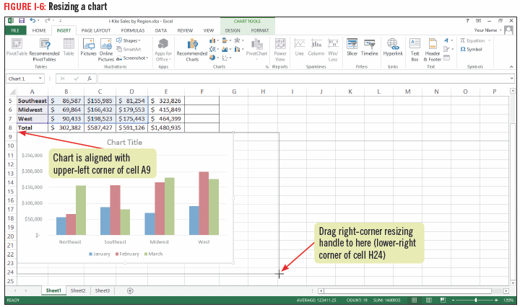
Moving and Resizing a Chart and Chart Elements

Slide 13
Applying Chart Layouts and Styles
Chart layout: A predefined arrangement of chart elements such as the legend and chart title
Chart style: A predefined set of chart colors and fills
You can instantly change the way chart elements are positioned, displayed or hidden by choosing a different layout from the Quick Layouts gallery
You can change fill colors and textures using the Chart Styles gallery

Slide 14
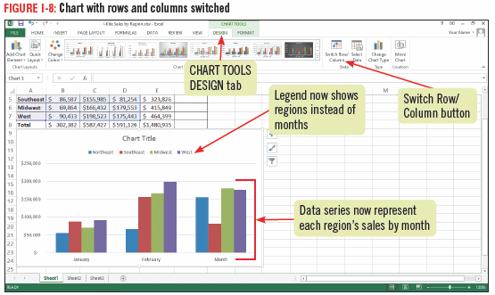
Applying Chart Layouts and Styles

Slide 15
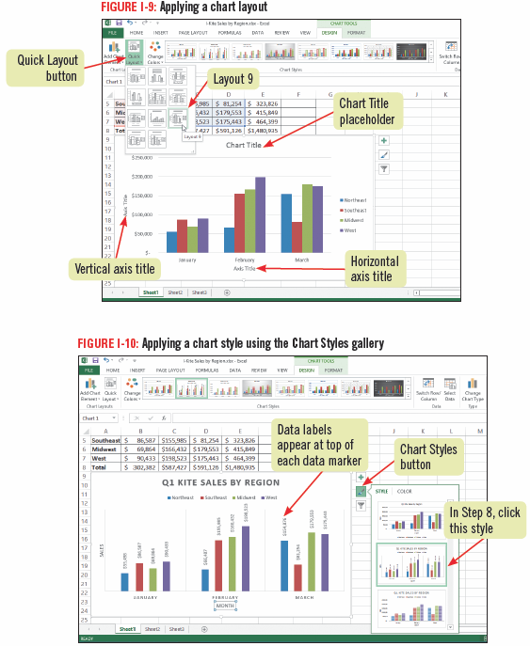
Applying Chart Layouts and Styles

Slide 16
Customizing Chart Elements
Chart objects have default settings
Customizable chart objects are the chart title, axis titles, legend, data labels, axes, gridlines, plot area, and data table
Data table: A grid containing the chart’s worksheet data
this grid is added below the x-axis in certain kinds of charts

Slide 17
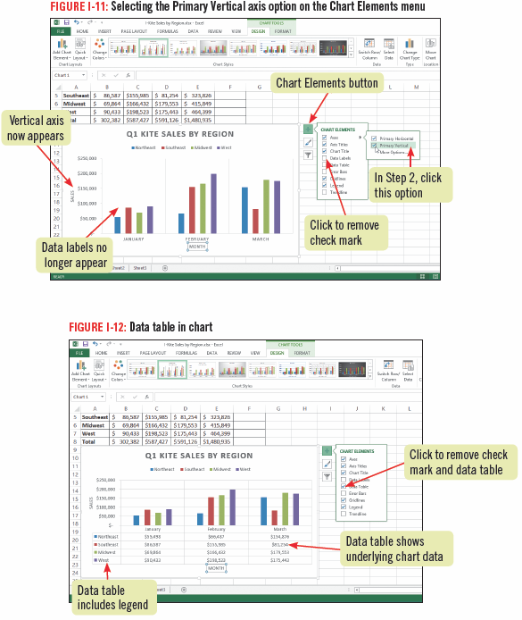
Customizing Chart Elements

Slide 18
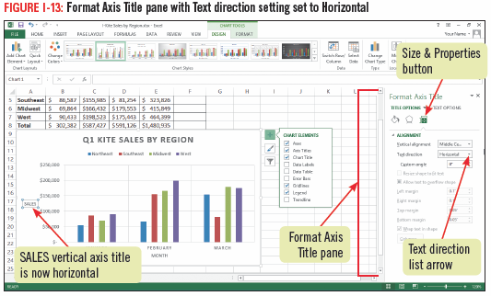
Customizing Chart Elements

Slide 19
Enhancing a Chart
Enhancing a chart with styles and effects improves its visual appeal and effectiveness
Any selected chart element can be modified in a variety of ways
apply a shape style
adjust the fill, outline and shape effects
apply WordArt styles
An example of an enhanced chart object
Chart Title

Slide 20
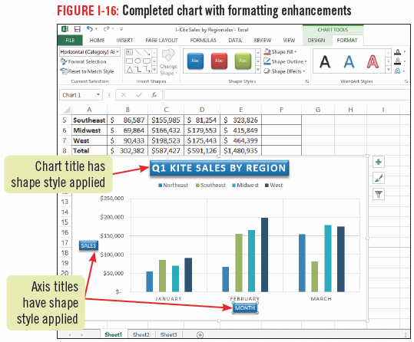
Enhancing a Chart

Slide 21
Creating a Pie Chart
A pie chart is an effective tool for comparing the relative values of pasts to a whole
Add a pie chart to the worksheet or add it as a separate chart sheet
A chart sheet is a sheet in a workbook that contains only a chart

Slide 22
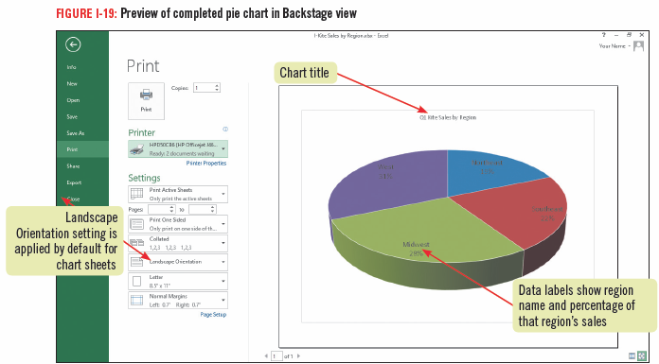
Creating a Pie Chart

Slide 23
Creating Sparklines
Sparklines are tiny charts that fit in one cell and illustrate trends in selected cells
There are three types of sparklines you can add to a worksheet:
Line sparkline is a miniature line chart that is ideal for showing a trend over a period of time
Column sparkline is a tiny column chart that includes a bar for each cell in a selected range
Win/Loss sparkline shows tow types of bars—one for gains and one for losses

Slide 24
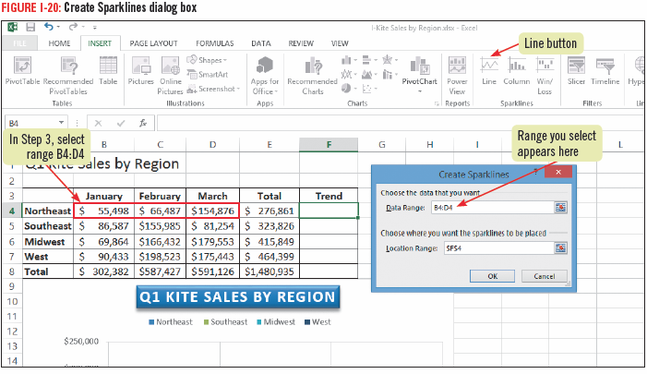
Creating Sparklines

Slide 25
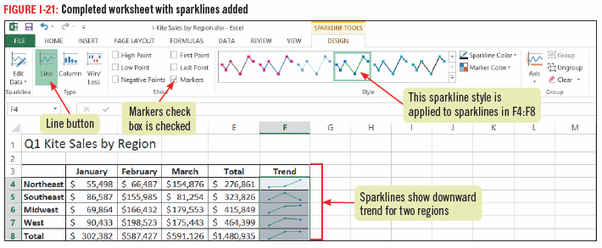
Creating Sparklines

Slide 26
Creating Sparklines

