Slide 1
Using Complex Formulas, Functions, and Tables

Slide 2
Objectives
Create complex formulas
Use absolute cell references
Understand functions
Use date and time functions
Use statistical functions
Apply conditional formatting
Sort rows in a table
Filter table data

Slide 3
Creating Complex Formulas
Complex formulas are formulas that contain more than one operator
When a formula contains multiple operators, Excel uses the order of precedence to determine which calculations to perform first
Calculations are performed in this order: calculations in parentheses first, exponential calculations, multiplication, division, addition, subtraction
multiple calculations within parentheses are performed to this same order

Slide 4
Creating Complex Formulas

Slide 5
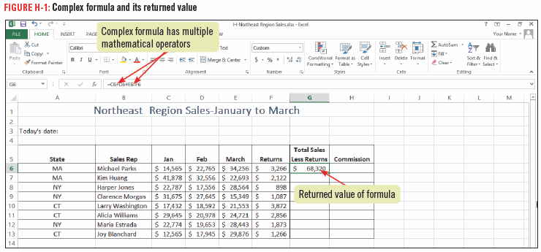
Creating Complex Formulas

Slide 6
Using Absolute Cell References
When you copy a formula from one cell to another, Excel automatically adjusts the cell references
There may be times that you do not want the cell reference to change, in this case you use an absolute cell reference in the formula
An absolute cell reference is a cell reference that always stays the same, even when copying
absolute cell references contain a $ symbol before the column letter and row number (such as $A$1)
to insert an absolute reference, click the cell you want to use and then press [F4]

Slide 7
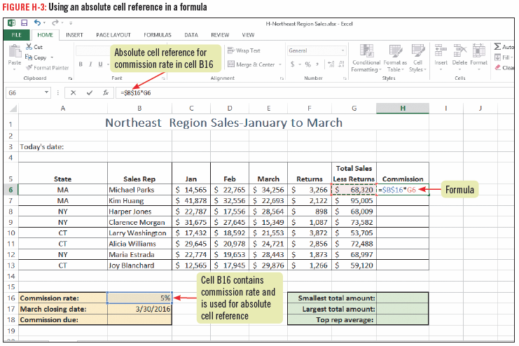
Using Absolute Cell References

Slide 8
Understanding Functions
Functions are prewritten formulas that come with Excel
You can use a function to compose the formula for you
save time
improve accuracy
can be simple or complex
Each Excel function has a name, usually written in capital letters
the SUM function adds values, the AVERAGE function calculates the average of a specified range, and the COUNT function counts the number of cells in a range containing numbers

Slide 9
Understanding Functions
There are four parts to each function:
equal sign,
function name,
a set of parentheses,
and arguments separated by commas and enclosed in parentheses

Slide 10
Understanding Functions
Arguments are all the information a function needs to perform a task
Arguments can be values such as (100 or .02), cell references (such as B3), or range references (such as A9:G16)
Anytime you type an equal sign followed by a letter, a list of valid functions and names beginning with that letter appear which is called Formula AutoComplete

Slide 11
Using Date and Time Functions
The Excel date and time functions let you display the current date and/or time in the worksheet
Help you calculate time between events
Some date and time functions produce recognizable text values that can easily be displayed in a worksheet
Other date and time functions produce values that require special formatting

Slide 12
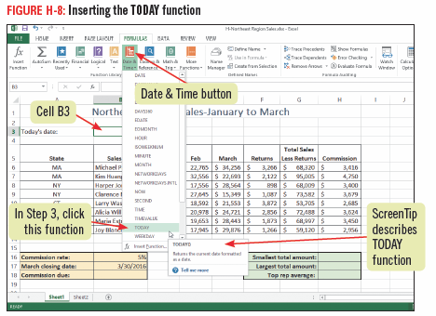
Using Date and Time Functions

Slide 13
Understanding how dates are calculated using serial values
Dates are stored as serial values (sequentially numbered since Jan. 1, 1900)
Dates are stored as serial values so that they can be used in calculations
Excel displays the serial value that represents the date and you can format the cell to display the date as you desire

Slide 14
Using Statistical Functions
Excel includes many statistical functions with the most popular being AVERAGE, MIN and MAX
AVERAGE -- calculate the average of a range of cells
MIN/MAX – calculate the smallest or largest value in a range of cells
These functions are available either on the AutoSum list menu or by using the Quick Analysis gallery, which provides easy access to common functions and formatting tools
To access all statistical functions, click More Functions in the Function Library group on the FORMULAS tab, then click Statistical

Slide 15
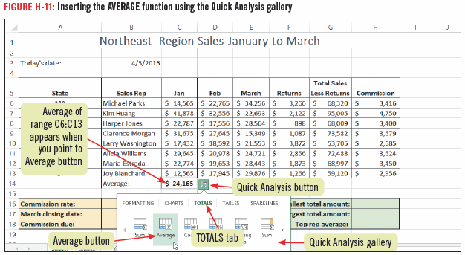
Using Statistical Functions

Slide 16
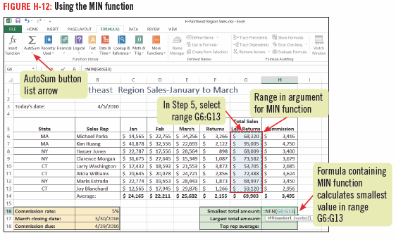
Using Statistical Functions

Slide 17
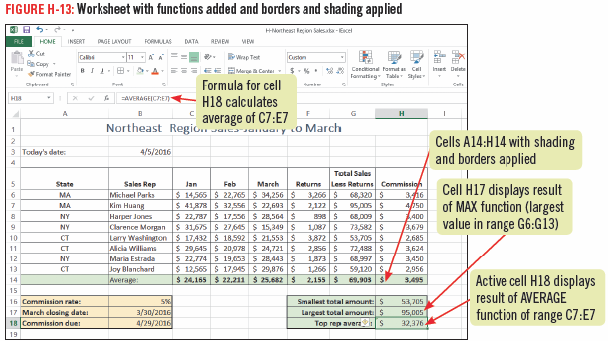
Using Statistical Functions

Slide 18
Applying Conditional Formatting
Conditional formatting is used to highlight or emphasize certain information in a worksheet
you specify the conditions to be met for the data to be emphasized such as highest and lowest product sales
Excel applies conditional formatting to cells when specified criteria are met
Color scales are shading patterns that use two or three colors to show the relative values of a range of cells
Data bars make it easy to quickly identify the large and small values in a range of cells

Slide 19
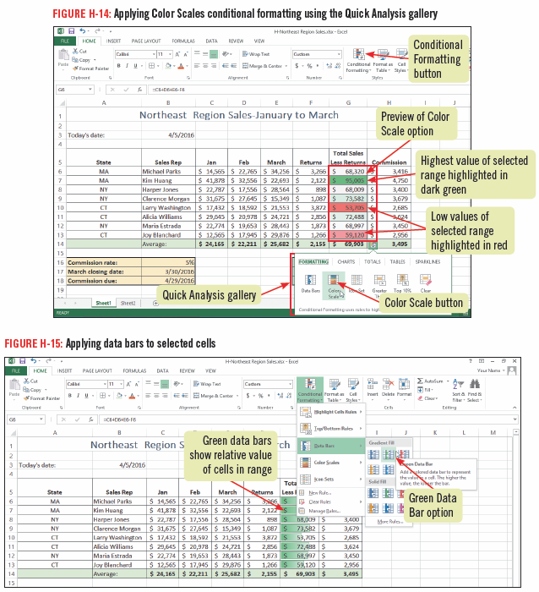
Applying Conditional Formatting

Slide 20
Sorting Rows in a Table
A table in Excel consists of rows and columns of data with a similar structure
You can manage and analyze this data separately from the rest of the worksheet
You can sort, or change the order of the table rows,
You use the Format as Table button to specify the cell range for the table and the appropriate style

Slide 21
Sorting Rows in a Table
An Excel table is similar to a table in a database because you can sort data in much the same way
Excel table columns are often called fields and rows of data are called records
In a table, the header row is the row at the top that contains column headings
A total row can be added at the bottom of a table when you want to add totals

Slide 22
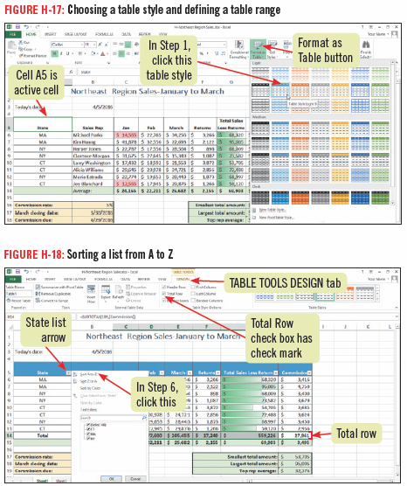
Sorting Rows in a Table

Slide 23
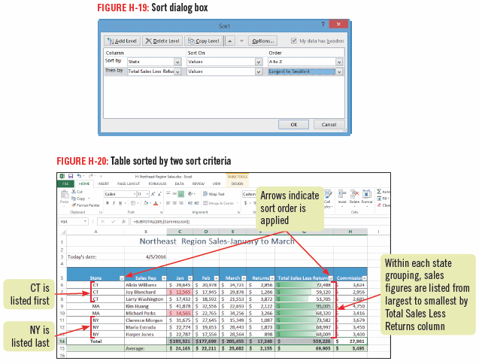
Sorting Rows in a Table

Slide 24
Filtering Table Data
A filter displays only the data you need
You specify the data you need by setting criteria
You can apply a filer to a table by using the filter list arrows that appear to the right of each column heading
A filter does not change the order of the items in the table (like a sort); it temporarily hides data not meeting the specified criteria

Slide 25
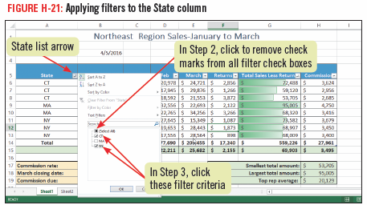
Filtering Table Data

Slide 26
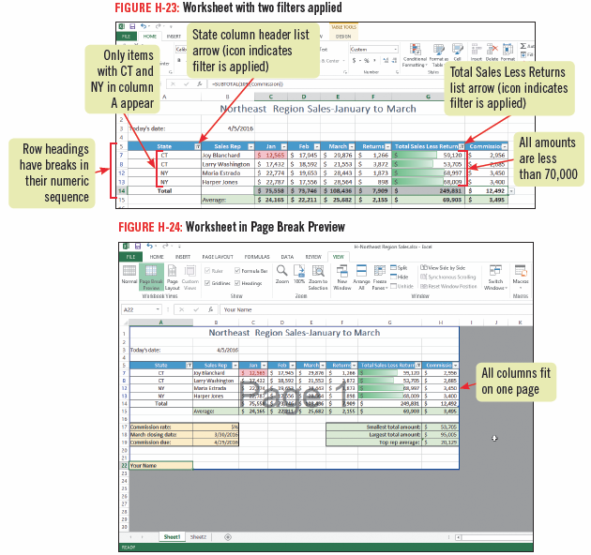
Filtering Table Data

