Slide 1
Staff Orientation
The Right Fit
Your Name
Notes:
Welcome students and ask them to introduce themselves

Slide 2
Facility Overview
Facility includes a 20,000 square foot state-of-the-art gym and weight room
Client services include:
  Personalized fitness assessments
  Training programs
  Fitness classes
The Right Fit

Slide 3
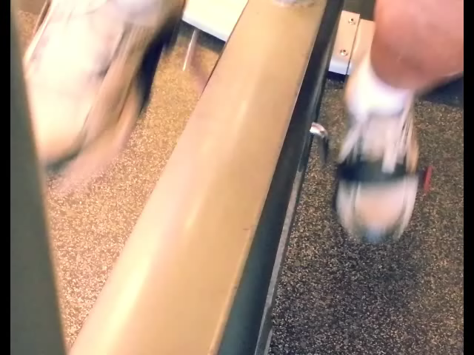
Equipment
Cardio
  Treadmills,
  Stationary Bicycles
  Elliptical Trainers
Strength Training
  Free Weights
  Cable and Hammer Strength

Slide 4
Staff Conduct
Please be sure to arrive on time
Be courteous and helpful to facility members
Verify instructions with supervisors
Provide sufficient notice of absences
Maintain a time sheet

Slide 5
Performance Review
Conducted once every six months
Purpose:
  Celebrate your successes
  Identify areas for improvement
Review | Type
January | Oral
December | Written

Slide 6
Sample Jobs
Personal Trainers
  Perform fitness assessments
  Conduct personal training sessions
Front Desk Staff
  Sign in members
  Answer phones
Fitness Instructors
  Conduct fitness classes
  Assist with new class development

