Slide 1
Enhancing a Document

Slide 2
Objectives
Change font and font size
Change font color, style, and effects
Change alignment and line spacing
Change margin settings

Slide 3
Objectives
Set tabs
Set indents
Add bulleted and numbered lists
Apply Styles

Slide 4
Changing Font and Font Size
Choosing an appropriate font is important when formatting a document
Fonts help communicate the tone of the document
You can use either the HOME tab or the Mini toolbar to change font and font size
Fonts and font sizes can be set before typing or by selecting text and applying changes

Slide 5
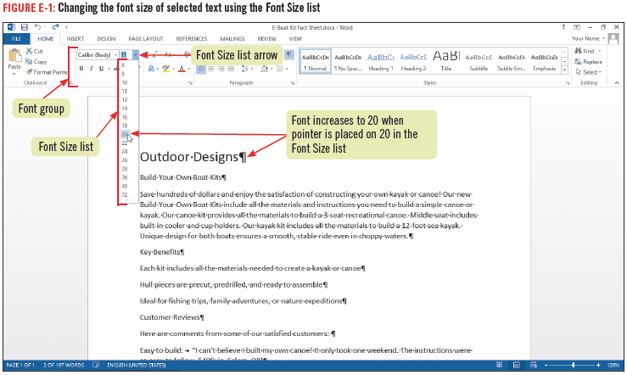
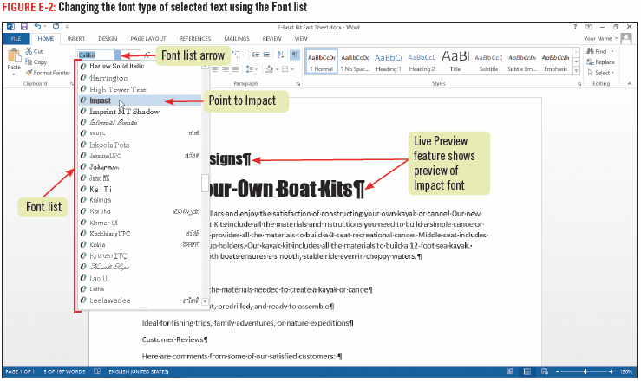
Changing Font and Font Size

Slide 6
Changing Font and Font Size

Slide 7
Changing Font Color, Style and Effects
Font attributes such as bold (darker type), italic (slanted type), and underline are used to emphasize certain words, or phrases
You can make certain words stand out by changing their color
Font effects, are special enhancements, such as shadow or strikethrough can be applied to selected text
You can use buttons in the Font group, or to save time you can use the Format Painter to copy formatting of selected text to other text

Slide 8
Changing Font Color, Style and Effects
Themes, a predesigned set of formatting elements, including colors, can be used to coordinate the look of your document
Standard colors, are the basic hues red, orange, and so on

Slide 9
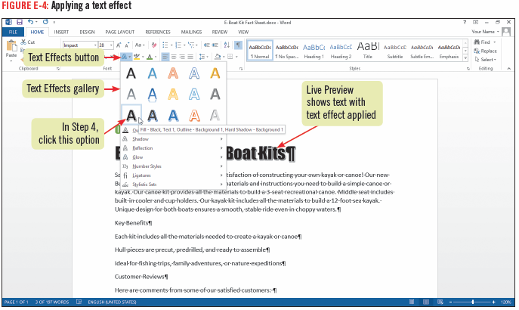
Changing Font Color, Style and Effects

Slide 10
Changing Alignment and Line Spacing
A margin is the amount of space between the edge of the page and the text
You can change the alignment, or position of text within a document’s margins
use the alignment buttons or specific buttons such as:
titles are often centered
Headings usually are left-aligned
Paragraphs are often justified (placed equally between the left and right margins)

Slide 11
Changing Alignment and Line Spacing
Using the Line and Paragraph Spacing button on the HOME tab adjusts the spacing between lines or between paragraphs
in Word, a paragraph is any text that ends with a hard return; it can be a one-word title or lengthy
Center-aligning text places the text equally between margins

Slide 12
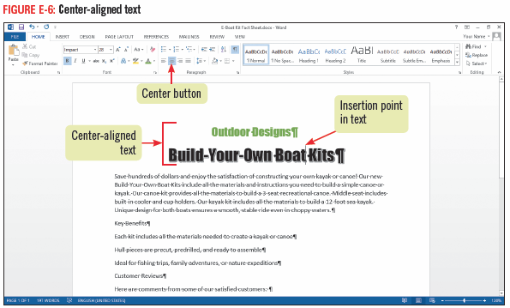
Changing Alignment and Line Spacing

Slide 13
Changing Margin Settings
By default, Word sets margins at
one inch from the top and bottom of the page
one inch from the left and right sides of the page
Word provides a number of additional preset margin settings
If none of the preset margins work, you can specify custom settings
When you change margins, Word automatically adjusts line wrapping and repaginates (renumbers the document pages)

Slide 14
Changing Margin Settings
To evaluate what margin settings to use in a document:
set the zoom level to One Page to work with the actual margins as they will appear on the page
To change the default margin settings, you will need to use the PAGE LAYOUT tab
The Margins list opens and displays ready-made options for margin settings

Slide 15
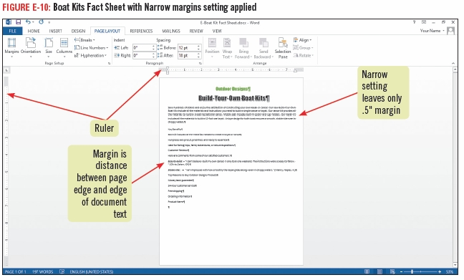
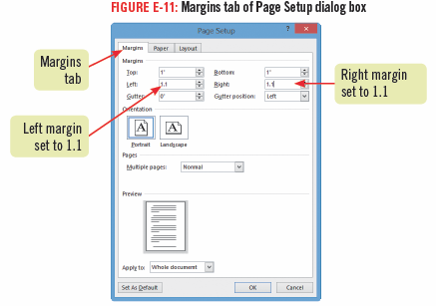
Changing Margin Settings

Slide 16
Setting Tabs
A tab is a set position where text following a tab character aligns
pressing [Tab] inserts a tab character, which appears as a right-facing arrow
The ruler makes it easy to set tab stops (locations the insertion point moves to when you press [Tab])
By default, Word sets left-aligned tab stops every ½ inch

Slide 17
Setting Tabs
Tab stops added to the ruler appear as a tab icon and override the default tab stop setting to the left of it
By default, new tab stops that you set on the ruler are left-aligned
you can use the tab selector on the ruler to align text differently such as to the right, or center
When you set tabs, they apply only to text you select, or if no text is selected, to the paragraph containing the insertion point

Slide 18
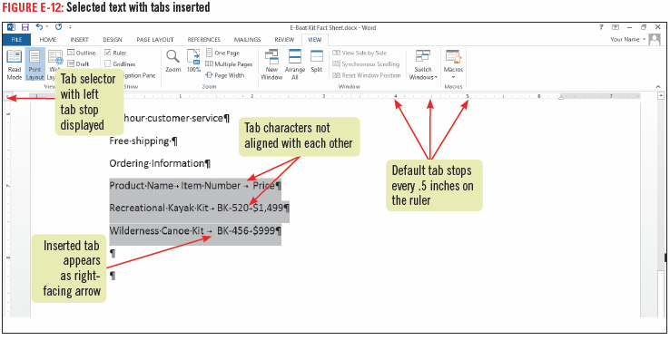
Setting Tabs

Slide 19
Setting Indents
An indent is a set amount of space between the edge of paragraph and the right or left margin
a first line indent indents the first line of text in a paragraph
a left indent indents the left edge of an entire paragraph
a right indent indents the right edge of an entire paragraph
a hanging indent aligns the text below the first line of paragraph text

Slide 20
Setting Indents
You can set indents using the sliding markers on the ruler, or
You can set left and right indents at ½” increments using the Increase Indent and Decrease Indent buttons on the HOME tab

Slide 21
Setting Indents

Slide 22
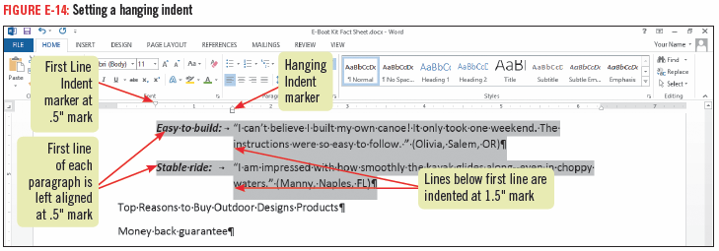
Setting Indents

Slide 23
Adding Bulleted and Numbered Lists
You can organize paragraphs into bulleted or numbered lists
there are many bullet and numbering styles to choose, or you can create a custom style
Word sets off the paragraph with a bullet and automatically formats the text with a hanging indent
Use a numbered (ordered) list when you want to present items in a particular sequence
A bulleted (unordered) list is used when the items are of equal importance

Slide 24
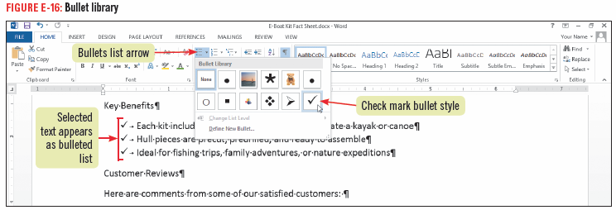
Adding Bulleted and Numbered Lists

Slide 25
Applying Styles
A style is a set of predefined formatting attributes
You can use styles to easily format your documents
To apply a style, click anywhere in the paragraph, then click the style you want in the Styles gallery, which is in the Styles group on the HOME tab

Slide 26
Applying Styles
Once you apply styles to a document, you can then change the look of the entire document in one click by applying a new style set
A style set is a group of professionally coordinated styles that look great together
Changing a style set changes all the styles in the document

Slide 27
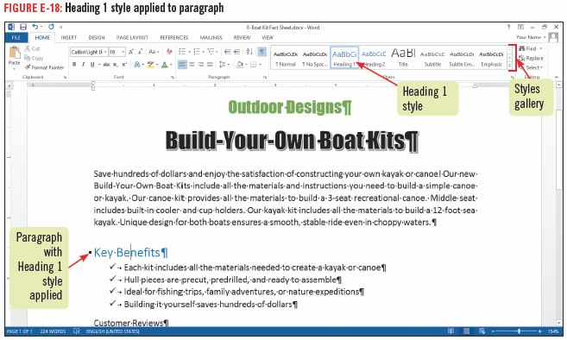
Applying Styles

