Slide 1
Understanding Essential
Computer Concepts

Slide 2
Objectives
Recognize you live and work in the digital world
Distinguish types of computers
Identify computer system components
Compare types of memory
Summarize types of storage media
Differentiate between input devices

Slide 3
Objectives
Examine output devices
Describe data communications
Define types of networks
Assess security threats
Understand system software
Describe types of application software

Slide 4
Distinguishing Types of Computers
A computer is an electronic device that:
accepts information and instructions from a user
manipulate the information according to instructions
display the information in some way
store the information for later retrieval

Slide 5
Distinguishing Types of Computers
The categories of computers are:
Personal computers (PCs)
Desktops
Laptops
Subnotebooks (Ultraportables or Minis)
Tablets
Handhelds
Smartphones
MP3 players
Mainframes and supercomputers

Slide 6
Distinguishing Types of Computers
Personal computers (PCs) are used for general computing tasks, usually for home or office use.
Handheld computers are small computers that usually have more limited capabilities than traditional PCs Mainframes and supercomputers are used by large businesses, government agencies, and in science and education

Slide 7
Distinguishing Types of Computers
Laptop computer
hinged lid contains display
lower portion contains keyboard
powered by rechargeable batteries
Smartphones
used to make and receive phone calls
also used to maintain an address book and calendar, send email, connect to the Internet, play music, and take photo or video
Tablets
thin computers without an external keyboard or mouse
interact with touch screen or stylus
ideal for surfing the Web, checking email, reading electronic books, watching video, and creating artwork

Slide 8
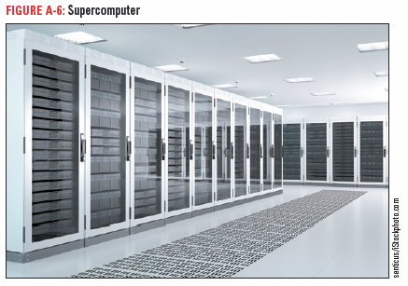
Distinguishing Types of Computers
Mainframe computers and supercomputers are used by large businesses, government agencies, and in science and education. They provide centralized storage and processing, and can manipulate tremendous amounts of data

Slide 9
Identify Computer System Components
A computer system is made up of:
Hardware—the physical components
Software—the programs or data routines
Architecture or configuration is the design and construction of the computer.
Specifications are the technical details about each hardware component.

Slide 10
Identify Computer System Components
Data
Numbers, words, figures, sounds, and graphics that describe people, events, things, and ideas
Processing
Modifying data

Slide 11
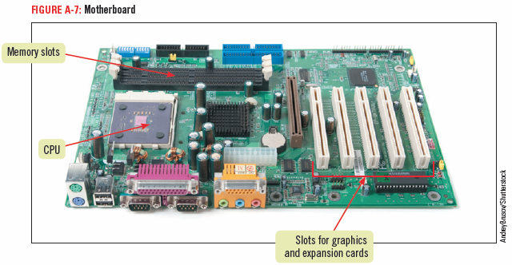
Identify Computer System Components
Motherboard
located inside the computer
the main electronic component of the computer
contains the CPU
Cards are removable circuit boards that are inserted into slots in the motherboard

Slide 12
Identify Computer System Components
Input — data you give to a computer
Output — result of the computer processing your input
Peripheral devices — accomplish the input, output, and storage functions

Slide 13
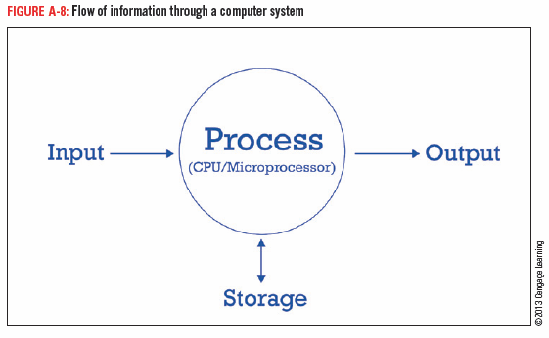
Identify Computer System Components
Microprocessor
also called processor, central processing unit or CPU
a silicon chip designed to manipulate data
speed determined by:
Clock speed
Word size
Processor type

Slide 14
Compare Types of Memory
Memory stores instructions and data.
There are five types of memory:
Random access memory (RAM)
Cache memory
Virtual memory
Read-only memory (ROM)
Complementary metal oxide semiconductor memory (CMOS)

Slide 15
Compare Types of Memory
RAM
Temporary memory that constantly changes while computer is on
You can upgrade the memory capacity
Cache memory
Special high-speed memory on the motherboard or microprocessor
Stores frequently and recently accessed data and commands

Slide 16
Compare Types of Memory
Virtual memory is extra memory that simulates RAM if more is needed.
Read-only memory (ROM) is the permanent storage location for a set of instructions the computer uses.
CMOS memory is semi-permanent and stores information such as the date, time, and system parameters.

Slide 17
Summarize Types of Storage Media
Three types of storage media:
Magnetic storage media
Optical storage devices
Flash memory

Slide 18
Summarize Types of Storage Media
Common magnetic storage devices
hard disks—several spinning platters usually sealed in a case inside the computer
Optical storage devices
CD—stores 700 MB of data
DVD—stores 4.7-15.9 GB
Blu-ray—stores 25 GB, used for storing high-definition video

Slide 19
Summarize Types of Storage Media
Flash memory (solid state storage) —similar to ROM except that it can be written to more than once.
Flash memory cards
small, portable cards encased in hard plastic to which data can be written and rewritten
used in digital cameras, handheld computers, video game consoles, and other devices
USB flash storage device (USB drive, flash drive)
popular type of flash memory
available in a wide range of sizes up to 512 GB of data
plug directly into the USB port of a personal computer

Slide 20
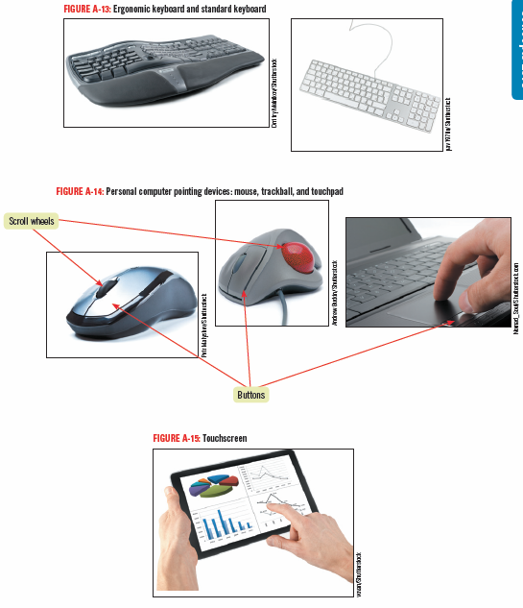
Differentiate Between Input Devices
Some input devices are:
Keyboard
Pointing
device
Mouse
Trackball
Touch pad
Touch screen
Microphone
Scanner

Slide 21
Understanding Assistive Devices
People who cannot use their arms or hands instead can use foot, head, or eye movements to control the pointer.
People with poor vision can use keyboards with large keys for input, screen enlargers to enlarge the size of objects on the monitor, or screen readers that speak on-screen content aloud.

Slide 22
Explain Output Devices
Monitors and printers are common output devices.
LCD monitors create an image by modulating light within a layer of liquid crystal
Some use LED technology as a backlight
Factors that influence a monitor’s quality are:
Screen Size
Resolution

Slide 23
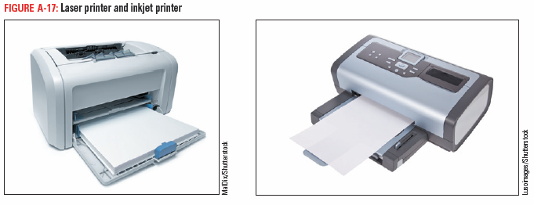
Explain Output Devices
Types of printers
Laser– high quality
Inkjet– popular for home use
Dot matrix– used to print large quantities

Slide 24
Describe Data Communications
Data communications is the transmission of data from one computer to another or to a peripheral device.
The four essential components of data communications are:
Sender
Channel
Receiver
Protocols

Slide 25
Describe Data Communications
A sender is the computer that originates the message.
The message is sent over a channel, such as a telephone.
The receiver is the computer at the message’s destination.
Protocols are the rules that establish the transfer of data between sender and receiver.

Slide 26
Describe Data Communications
Device driver (or driver)
handles the transmission protocol between a computer and its peripheral devices
a computer program that can establish communication because it contains information about the characteristics of your computer and of the device
Data bus
data path between the microprocessor, RAM, and the peripherals along which communication travels

Slide 27
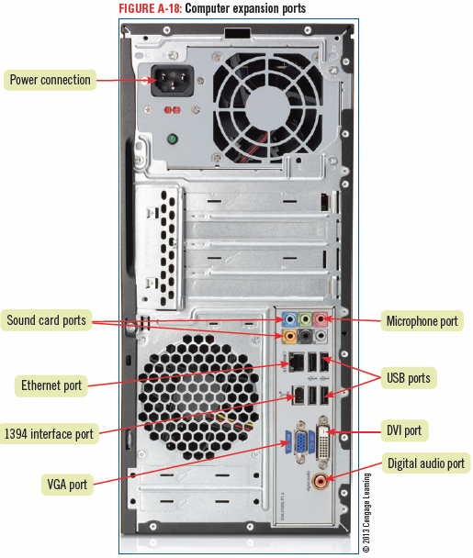
Describe Data Communications
PCs have several types of expansion ports:
Parallel
Serial
USB
MIDI
Ethernet
Thunderbolt
HDMI
DVI
VGA

Slide 28
Describe Data Communications
USB (Universal Serial Bus) port—a high-speed serial port which allows multiple connections at the same port
Ethernet port—used to connect to another computer, a LAN, a modem, or sometimes directly to the Internet; allows data to be transmitted at high speeds.
HDMI (high definition multimedia interface) and DVI (digital interface)—digitally transmits both video and audio
VGA (video graphics array) allows analog transmission of video

Slide 29
Define Types of Networks
Network
connects one computer to other computers and peripheral devices
Network interface card (NIC)
creates a communications channel between the computer and the network
a cable connects the NIC port to the network
Network software
establishes the communications protocols that will be observed on the network
controls the traffic flow of data traveling through the network

Slide 30
Define Types of Networks
Server
acts as the central storage location for programs
provides mass storage for most of the data used on the network
Client/server network— a network with server that acts as the central storage location
Peer-to-peer network
a network without a server
all of the computers are equal

Slide 31
Define Types of Networks
Standalone computer—a personal computer that is not connected to a network
Workstation—a personal computer that is connected to a network
Node—any device connected to the network

Slide 32
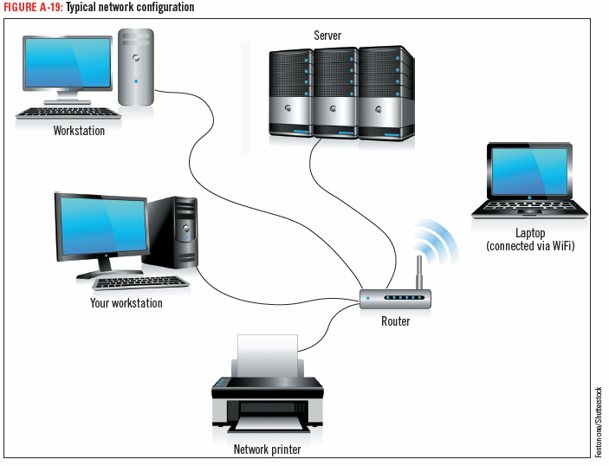
Define Types of Networks

Slide 33
Define Types of Networks
LAN (local area network)
Nodes located close to each other
WAN (wide area network)
more than one LAN connected together
the Internet is the largest example of a WAN
WLAN (wireless local area network)
devices connected using radio waves instead of wires
Wi-Fi (wireless fidelity) describes WLANs connected using a standard radio frequency established by the Institute of Electrical and Electronics Engineers (IEEE)

Slide 34
Define Types of Networks
PAN (personal area network)— a network that allows two or more devices located close to each other to communicate or to connect a device to the Internet
Infrared technology—uses infrared light waves to beam data from one device to another
Bluetooth—uses short range radio waves to connect a device wirelessly to another device or to the Internet

Slide 35
Assess Security Threats
Security
the steps a computer user takes to prevent unauthorized use of or damage to the computer

Slide 36
Assess Security Threats
Malware
any program intended to cause harm or convey information to others without the owner’s permission
Viruses
harmful programs that instruct your computer to perform destructive activities, such as erasing a disk drive
Antivirus software (virus protection software) searches executable files for the sequences of characters that may cause harm and disinfects the files by erasing or disabling those commands
Spyware
secretly gathers information from your computer and sends this data back to the company or person that created it
usually installed without the computer user’s permission or knowledge
Anti-spyware software detects spyware and deletes it

Slide 37
Assess Security Threats
Firewall
prevents other computers on the Internet from accessing a computer and prevents programs on a computer from accessing the Internet without the computer user’s permission
can be either hardware or software
Hardware firewalls provide strong protection from incoming threats
Many routers come with built-in firewalls
Software firewalls track all incoming and outgoing traffic

Slide 38
Assess Security Threats
Spoofed site
a website set up to look like another website, but which does not belong to the organization portrayed in the site
has a URL (address on the web) that looks similar to a URL from the legitimate site
usually set up to try to convince customers of the real site to enter personal information
Phishing
the practice of sending email to customers or potential customers of a legitimate website asking them to click a link in the email
the link leads to a spoofed site
Pharming
when a criminal breaks into a DNS server (a computer responsible for directing Internet traffic) and redirect any attempts to access a particular website to the criminal’s spoofed site

Slide 39
Protecting Information with Passwords
Logging in / Logging on
signing in with a username and password
Strong password
at least eight characters
consists of upper- and lowercase letters and numbers
does not include common personal information

Slide 40
Understand System Software
System software helps the computer carry out its basic
operating tasks.
The four types of system software are:
Operating systems
Utilities
Device drivers
Programming languages

Slide 41
Understand System Software
Operating system
allocates system resources
controls the input and output (I/O)
manages files on storage devices
guards against equipment failure
Operating environment
provides a graphical user interface (GUI) that acts as a liaison between the user and the computer

Slide 42
Understand System Software
Utility software
helps analyze, optimize, configure, and maintain a computer
Device drivers
handle the transmission protocol between a computer and its peripherals
when you add a device to an existing computer, part of its installation includes adding its device driver to the computer’s configuration
Programming languages
used by a programmer to write computer instructions

Slide 43
Describe Types of Application Software
Application software
enables you to perform specific computer tasks
Document production software
includes word processing software and desktop publishing software
has a variety of features that assist you in writing and formatting documents, including changing the font (the style of type), spell checking to help you avoid typographical and spelling errors, and adding simple drawings called clip art
Spreadsheet software
a numerical analysis tool
used to create a worksheet composed of a grid of columns and rows
you type data into the cells, and enter mathematical formulas into other cells that reference the data

Slide 44
Describe Types of Application Software
Database management software
lets you collect and manage data
Database
a collection of information stored on one or more computers organized in a uniform format of fields and records
field—one piece of information in the record
record—a collection of data items in a database
An example of a database is the online catalog of books at a library; the catalog contains one record for each book in the library, and each record contains fields that identify the title, the author, and the subjects under which the book can be classified.

Slide 45
Describe Types of Application Software
Presentation software
Allows you to create a visual slide show to accompany a lecture, demonstration, or training session
Multimedia authoring software
allows you to record digital image files, audio files, and video files
Information management software
Keeps track of schedules, appointments, contacts and to-do lists
Website creation and management software
allows you to create websites and mobile apps

