Slide 1
Using Complex Formulas, Functions, and Tables

Slide 2
Objectives
Navigate a workbook
Enter labels and values
Change columns and rows
Use formulas
Use AutoSum

Slide 3
Objectives
Change alignment and number format
Enhance a worksheet
Preview and print a worksheet

Slide 4
Navigating a Workbook
Microsoft Excel is a powerful program you can use to organize and analyze data
An Excel worksheet consists of a grid of rows and columns
Similar to a Word table, the intersection of a row and column is called a cell
An Excel file, called a workbook, can contain one or more worksheets
People sometimes refer to a worksheet or a workbook as a spreadsheet

Slide 5
Navigating a Workbook
The cell with the dark border in the upper-left corner of the worksheet is the active cell
The dark border surrounding the active cell is the cell pointer
To make a cell active you need to click on it
Every cell in a worksheet has a unique cell address; the intersection of a column and a row
When you first start Excel, the active cell in the new workbook is cell A1

Slide 6
Navigating a Workbook
The name box shows the address of the selected cell
The formula bar, located just above the column headings, shows the contents of the selected cell
A group of cells that share boundaries and are selected is call a cell range

Slide 7
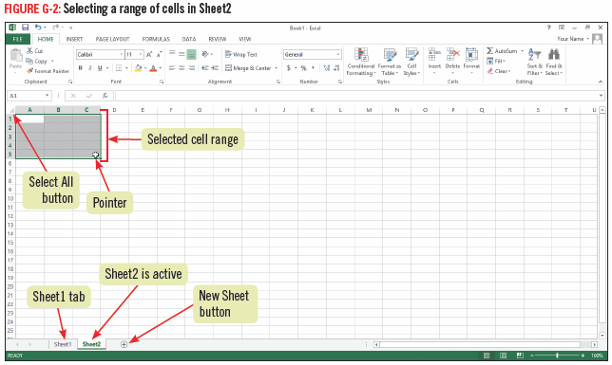
Navigating a Workbook

Slide 8
Navigating a Workbook

Slide 9
Entering Labels and Values
Entering data in a worksheet is similar to typing in a Word table
Select the cell in which you want to enter data, then type in the data
After typing the data, you must accept the entry by pressing [Enter]. [Tab], or an arrow key

Slide 10
Entering Labels and Values
Most worksheets contain labels and values
A label is text that describes data in a worksheet
Values are numeric data that can be used in calculations
You can edit a cell entry by double-clicking the cell to put the cell in Edit mode
In Edit mode, select the part of the cell entry you want to correct and type the correction

Slide 11
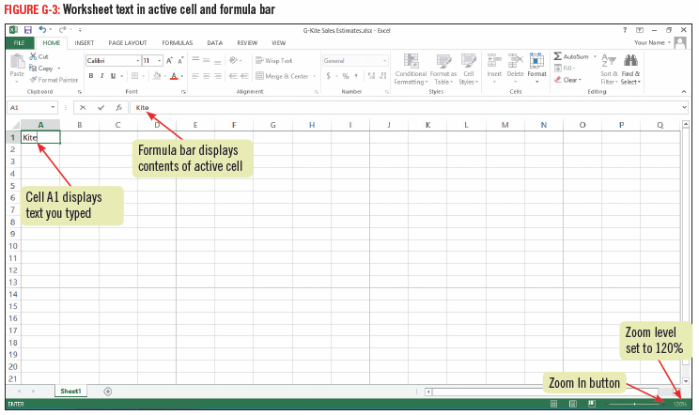
Entering Labels and Values

Slide 12
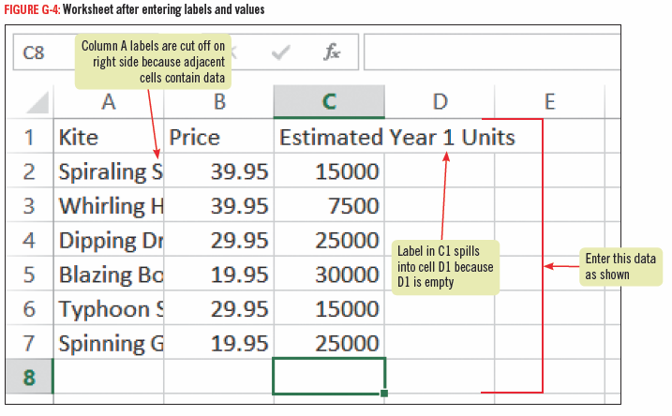
Entering Labels and Values

Slide 13
Working with Columns and Rows
You can adjust the width of a column or the height of a row using the mouse, ribbon, or shortcut menu
You can also insert or delete columns and rows using the Insert and Delete buttons in the Cells group on the HOME tab
The boxes containing letters are column headings
The boxes containing numbers in front of each row are row headings
AutoFit is a feature that adjusts the width of the column to fit the longest entry

Slide 14
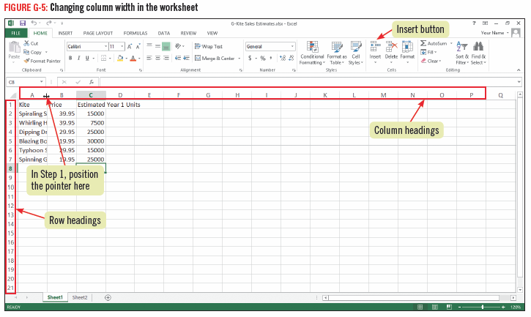
Working with Columns and Rows

Slide 15
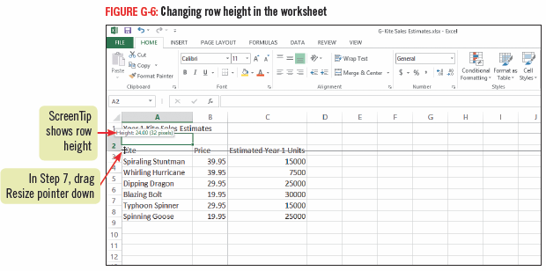
Working with Columns and Rows

Slide 16
Using Formulas
To perform a calculation in a worksheet, you use a formula which is an equation
Formulas start with an equal sign (=) and can contain numbers, mathematical operators, and cell references
A cell reference is a cell address, such as E44, that identifies the location of a value used in a calculation
If more than one operator is used in a formulas, Excel performs the calculations in the order of precedence

Slide 17
Using Formulas
You can copy and move formulas just like the other data in a worksheet
When you copy a formula to a new cell, Excel automatically replaces the original cell references with cell references that are in the same relative position as those in the original formula called relative cell referencing
You can use the small black square at the bottom right corner of a cell, known as the fill handle, to drag the content of a cell to other adjacent cell

Slide 18
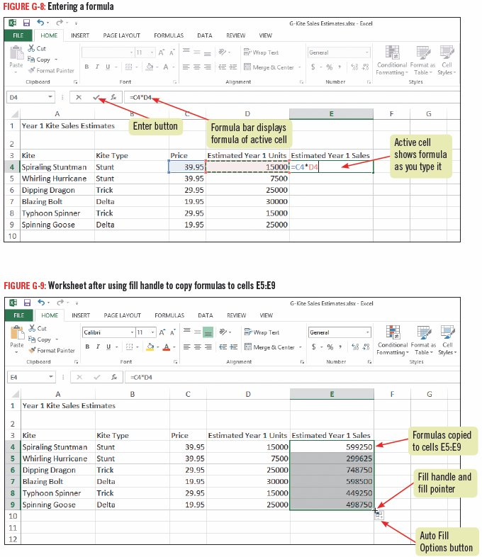
Using Formulas

Slide 19
Using Formulas

Slide 20
Using AutoSum
Excel comes with a wide variety of functions, which are prewritten formulas designed for particular types of calculations
The most frequently used worksheet function, SUM, totals all number and cell references included as function arguments
An argument is information a function needs to make a calculation

Slide 21
Using AutoSum
Functions save time and help ensure accuracy, and they are available for both simple calculations and extremely complex ones
Each Excel function has a name that you usually see in all capital letters such as AVERAGE or DATE
Because the SUM function is so commonly used, it has its own button on the HOME tab, also known as the AutoSum button

Slide 22
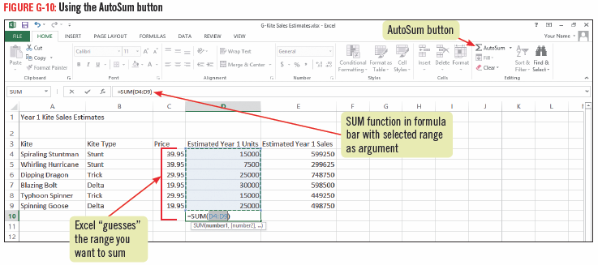
Using AutoSum

Slide 23
Changing Alignment and Number Format
Excel automatically left-aligns text and right-aligns values
Cell alignments can be changed using the buttons in the Alignment group on the HOME tab
You can also use the Merge & Center button to merge several cells into one cell and center the text in the merged cell
this is helpful in formatting a worksheet title so that it is centered above the worksheet data

Slide 24
Changing Alignment andNumber Format
You can change the format of numbers to make your worksheet easier to read using the buttons in the Numbers group
You can also insert rows and columns in your worksheet, when you do so, any cell references are updated to reflect the change

Slide 25
Changing Alignment and Number Format

Slide 26
Enhancing a Worksheet
You can enhance an Excel worksheet to make it look more professional and increase its visual appeal
In Page Layout view, you can add headers and footers containing information that you want to include at the top or bottom of each page
You can also apply cell styles, which are predefined formatting options to ensure that similar elements in your worksheet are formatted consistently

Slide 27
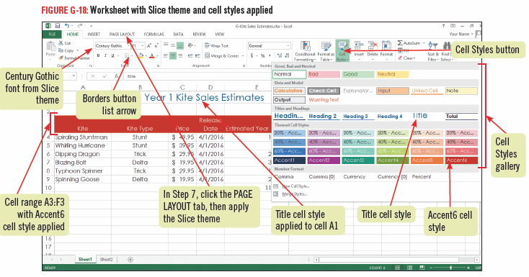
Enhancing a Worksheet

Slide 28
Previewing and Printing a Worksheet
When you finish working with a worksheet and have saved your work, you are ready to print
Just like in Word, you can use the Print tab in Backstage view to preview the printed worksheet and specify settings
you can change the orientation, adjust margins, specify the printer, specify the paper size and more

Slide 29
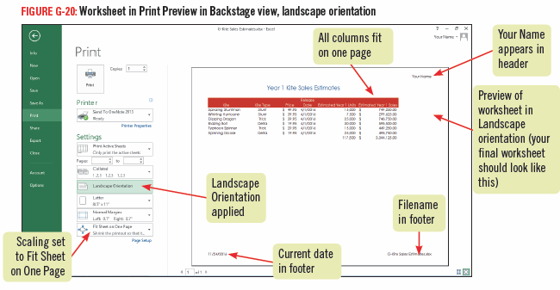
Previewing and Printing a Worksheet

