Slide 1
Working in the Cloud

Slide 2
Objectives
Understand Office 2013 in the Cloud
Work Online
Explore SkyDrive
Manage Files on SkyDrive

Slide 3
Objectives
Share Files
Explore Office Web Apps
Complete a Team Project

Slide 4
Understanding Office 2013 in the Cloud
The term cloud computing refers to the process of working with files and apps online
Applications such as Gmail and outlook.com are cloud-based, which means that you do not need a program installed on our computer to run them
Office 2013 has also been designed as a cloud-based application

Slide 5
Understanding Office 2013 in the Cloud
A roaming setting is a setting that travels with you on every connected device
SkyDrive is an online storage and file sharing service
The term synced means that when you add, change or delete files on one computer, the same files on your other devices are also updated
Office Web Apps are the versions of Microsoft Word, Excel, PowerPoint, and OneNote that you can access from your SkyDrive

Slide 6
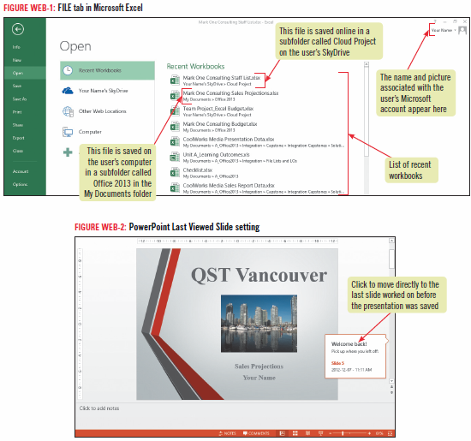
Understanding Office 2013 in the Cloud

Slide 7
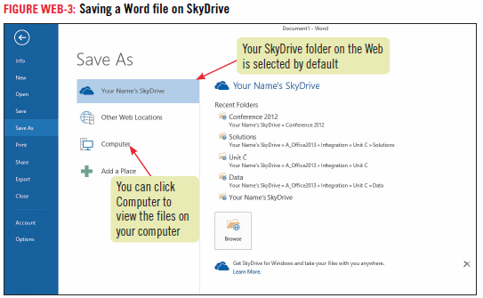
Understanding Office 2013 in the Cloud

Slide 8
Work Online
When you work on your own computer, you are usually signed in to your Microsoft account automatically
When you use another person’s computer or a public computer, you will be required to enter the password associated with your Microsoft account to access files you have saved on Windows SkyDrive
You know you are signed in to Windows when you see your name and possibly your picture in the top right corner of your screen

Slide 9
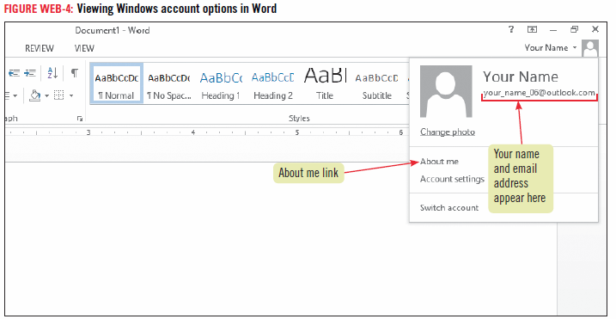
Work Online

Slide 10
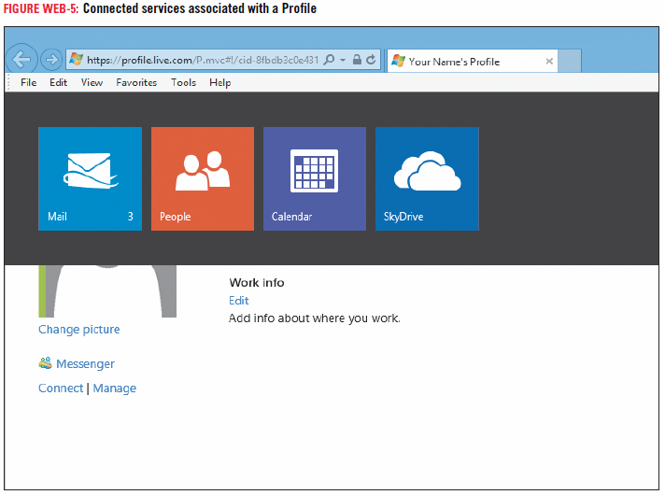
Work Online

Slide 11
Getting a Microsoft Account
You have a Microsoft account if you use
Outlook.com
SkyDrive
Xbox LIVE
Windows Phone
A Microsoft account consists of an email address and a password

Slide 12
Exploring SkyDrive
SkyDrive works like the hard drive on your computer
You can save and open files from SkyDrive, create folder, and manage your files
You can access the files you save on SkyDrive from any of your connected devices and from anywhere you have a computer connection

Slide 13
How to Disable Default Saving to SkyDrive
By default, files are saved to locations you specify on your SkyDrive
You can change the default to be a different location
Click the FILE tab, then click Options. Click Save in the left sidebar, then in the Save section, click Save to Computer by default check box

Slide 14
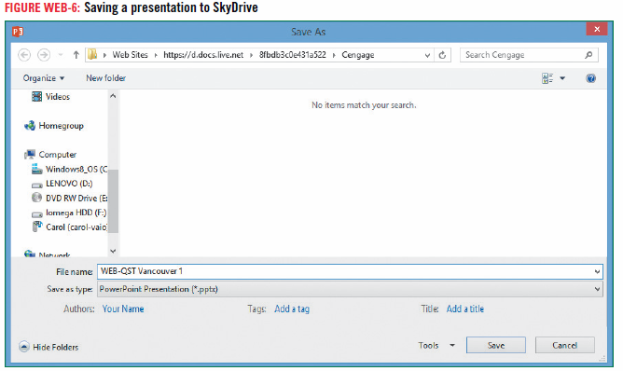
How to Disable Default Saving to SkyDrive

Slide 15
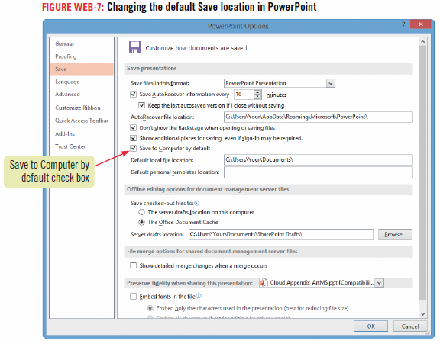
How to Disable Default Saving to SkyDrive

Slide 16
Managing Files on SkyDrive
You are automatically connected to SkyDrive when you sign into your Microsoft account and launch an Office 2013 application
You can also access SkyDrive through your Web browser or from the SkyDrive App in Windows 8
When you start the SkyDrive app, you can upload and download files, create folders, and delete files

Slide 17
Managing Files on SkyDrive
You can also download the SkyDrive app to your tablet or other mobile device so you can access files wherever you have an Internet connection
When you access SkyDrive from Internet Explorer, you can do more file management tasks, including renaming and moving files

Slide 18
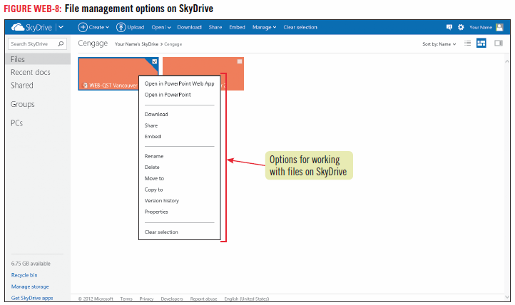
Managing Files on SkyDrive

Slide 19
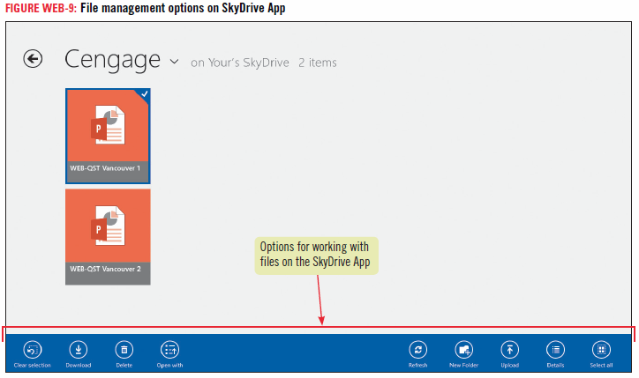
Managing Files on SkyDrive

Slide 20
Sharing Files
One of the great advantages of working with SkyDrive is that you can share your files with others
When you share files using SkyDrive, you only have to work with one version of the file

Slide 21
Co-authoring Documents
You can work with a document, presentation, or workbook simultaneously with a partner
Save the file to SkyDrive
Click the FILE tab, click Share, then click Invite People
Enter the email addresses of the people you want to work with the file
Click Share

Slide 22
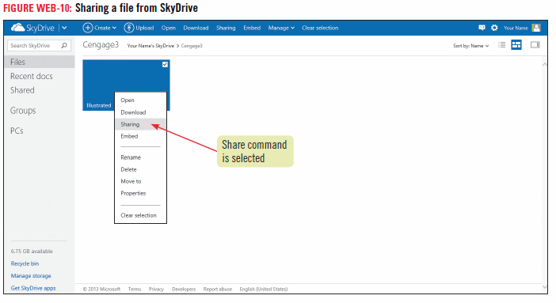
Sharing Files

Slide 23
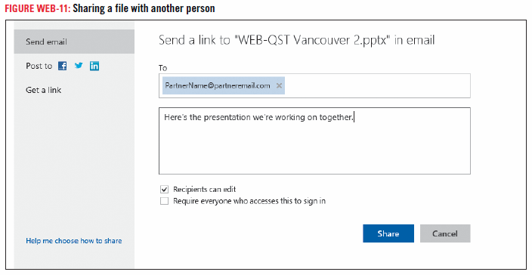
Sharing Files

Slide 24
Exploring Office Web Apps
A Web App is a scaled-down version of an Office program
Office Web Apps include Word, Excel, PowerPoint, and OneNote
You can use Office Web Apps to create and edit documents, even if you don’t have Office 2013

Slide 25
Exploring Office Web Apps

Slide 26
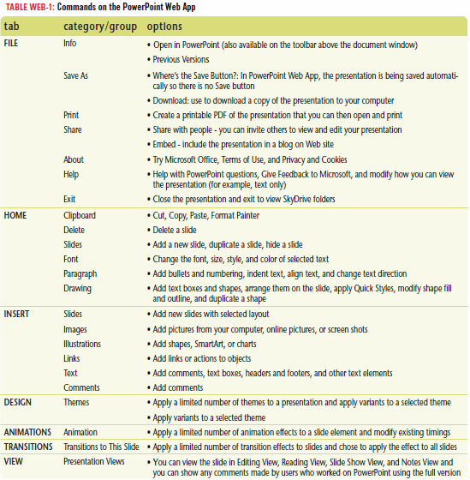
Exploring Office Web Apps

