Slide 1
Working with Data

Slide 2
Objectives
Open an existing database
Sort records in a table
Filter records in a table
Create a query
Modify a query in Design view

Slide 3
Objectives
Relate two tables
Create a query using two tables
Add a calculated field to a table

Slide 4
Opening an Existing Database
Opening an existing Access database is similar to opening a Word or an Excel file
From the Access Start screen, you click the Open Other Files command to open the Open screen, navigate to the folder where the file is located, then double-click the file you want

Slide 5
Opening an Existing Database
One difference between opening an Access database and opening a file in Word or Excel is that you can only open one Access database file at a time
For multiple databases to be open you will need to open additional sessions of Access and then open the database

Slide 6
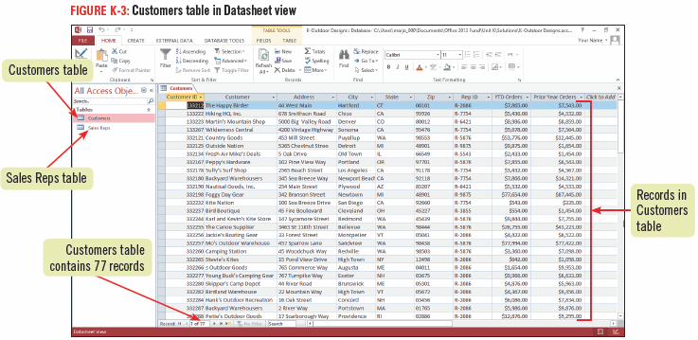
Opening an Existing Database

Slide 7
Sorting Records in a Table
You can rearrange, or sort, the records in a table in alphabetical or numerical order
When sorting you need to indicate the field on which you want Access to sort and then specify:
Ascending order: A-Z or 0-9
Descending order: Z-A or 9-0
You might also want to sort records using more than one field, an example might be to sort by a customer name within a specific state

Slide 8
Capturing a screen shot of your sorted table
To capture a screen shot, start Microsoft Word, click the INSERT tab, click the Screenshot button, then click the image of the screenshot in the Available Windows menu
The screen shot of a sorted table will be pasted into a new Word document which can be saved
Click the Access program button on the taskbar to return to Access

Slide 9
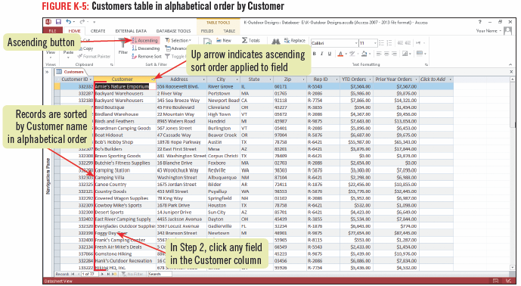
Sorting Records in a Table

Slide 10
Sorting on multiple fields
When sorting on multiple fields you need to decide which one will be the primary sort field and which field is to be sorted within the primary field grouping
The field that is primary is called the outermost sort field, and the field that is the secondary sort field is called the innermost sort field
To get the results you want, you must first sort the records by the innermost field and then sort by the outermost field

Slide 11
Filtering Records in a Table
Records in a table can be filtered to display only the information that meet criteria that you specify
Criteria are conditions that must be met for a record to be displayed
The simplest way to filter a table is to select a field that matches your criterion and use the Equals command to display those records that match the selection

Slide 12
Filtering Records in a Table
You can also apply a Number Filter to a selected field to filter records that are greater than, less than, or equal to a specific number or between two different numbers
Filters cannot be saved as a database object
Filters can be saved as part of the table or form you are working on and reapply it the next time
Filter results can also be printed

Slide 13
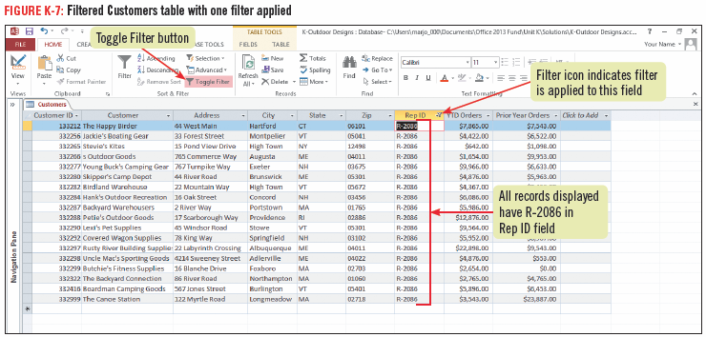
Filtering Records in a Table

Slide 14
Creating a Query
A query is a database object that extracts data from one or more tables in a database according to criteria that you set
A query displays only the fields you specify
You can use a query to pull together information from several tables
As a query is an object, you can save it for later use
The simplest way to create a query is by using the Query Wizard

Slide 15
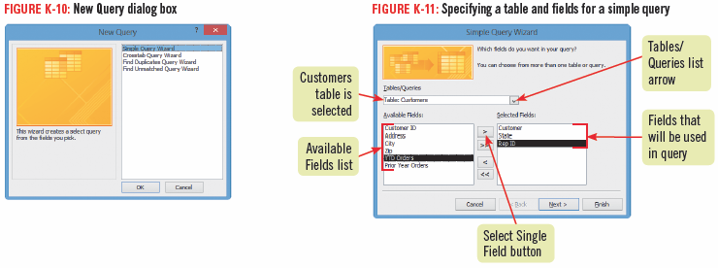
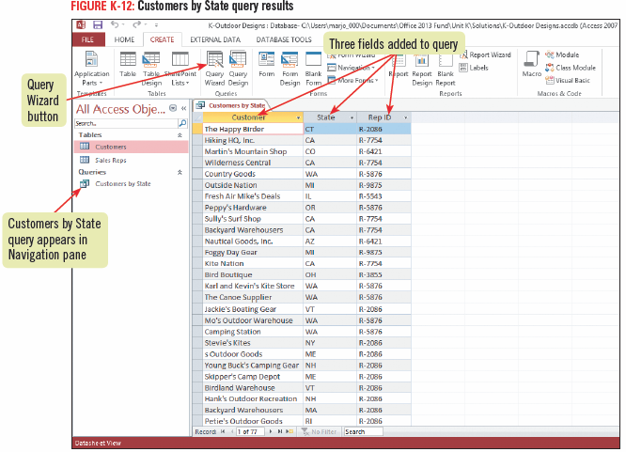
Creating a Query

Slide 16
Creating a Query

Slide 17
Modifying a Query in Design View
You can modify an existing query if you need to make changes using Design view
In Design view, you can:
add fields
delete fields
specify a sort order for one or more fields
specify criteria for fields
create a query

Slide 18
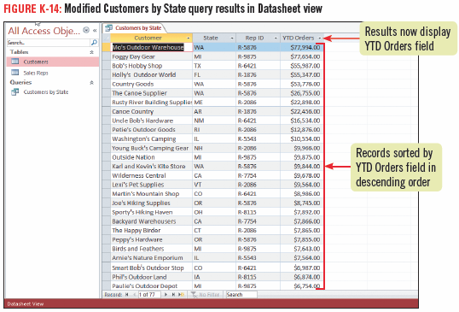
Modifying a Query in Design View

Slide 19
Relating Two Tables
To take advantage of the power of Access you may want to create queries that pull fields from more than one table
Queries can be used to relate two tables, or specify a relationship between them
To relate tables, they must share a common field
The shared field must be the primary key field in one of the tables

Slide 20
Relating Two Tables
You use the Relationships window to specify a relationship between two or more tables
The most common type of relationship to set up is a one-to-many relationship, in which the primary key field in one table is associated with multiple records in a second table
In the second table, the common field shared with the first table is called the foreign key

Slide 21
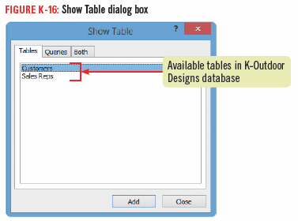
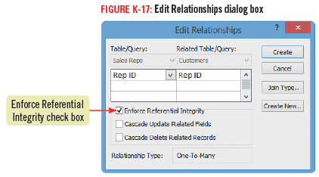
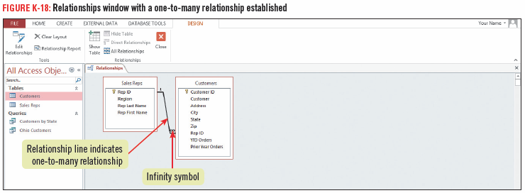
Relating Two Tables

Slide 22
Understanding good database design
Creating a well-designed database requires careful planning
What is the purpose?
What data will it store?
organize the database into categories of data
turn the categories of data into tables
define fields, data types and primary key
decide table relationships
Creating a well-designed structure for your database will ensure that your data is easy to access, maintain, and update

Slide 23
Creating a Query Using Two Tables
Setting up relationships between tables offers many advantages:
ability to create a query that pulls fields from two or more related tables
changes made to fields in one table are automatically reflected in related tables or queries (if referential integrity is selected)
This ensures consistent, accurate data

Slide 24
Creating a Query Using Two Tables
Setting up table relationships also ensures that your data is valid and accurate
Access will prohibit any attempt to enter data in the foreign key field that is not consistent with the data in the primary key field

Slide 25
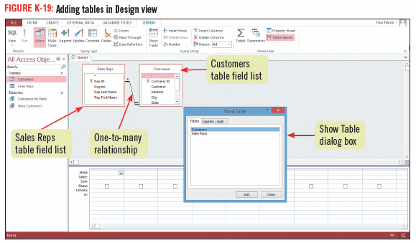
Creating a Query Using Two Tables

Slide 26
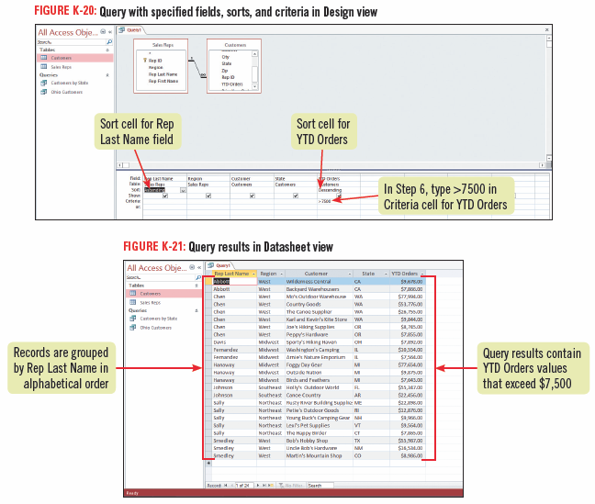
Creating a Query Using Two Tables

Slide 27
Creating a Query Using Two Tables

Slide 28
Adding a Calculated Field to a Table
A calculated field is a field that contains an expression, which is a combination of fields, values, and mathematical operators
Showing the results of calculations based on values in certain fields is very useful
Calculated fields have the Calculated data type
Choosing a Calculated data type opens the Expression Builder dialog box where you can easily build the expression you want by specifying fields, values, and operators

Slide 29
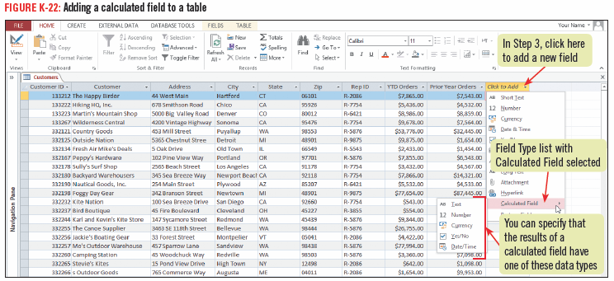
Adding a Calculated Field to a Table

