Slide 1
Creating a Database

Slide 2
Objectives
Understand databases
Create a database
Create a table in Datasheet view
Create a table in Design view

Slide 3
Objectives
Modify a table and set properties
Enter data in a table
Edit data in Datasheet view
Create and use a form

Slide 4
Understanding Databases
Access is a database management system (DBMS)
A database is a powerful tool for:
Storing
Organizing
Retrieving information
A database containing just one table is called a simple database; two or more tables of related information is called a relational database

Slide 5
Understanding Databases
A database stores data in or more spreadsheet-like lists called tables
Each row in a table is called a record
records consists of fields, which are columns holding information about one aspect of a record
column headings are field names
a form is a user-friendly window that is used to input data

Slide 6
Understanding Databases
One you add data to a database you can easily access it
A query extracts data from one or more database tables according to set criteria
A report is a summary of information pulled from the database specifically designed for printing
Tables, forms, queries, and reports are program components called objects

Slide 7
Understanding Databases

Slide 8
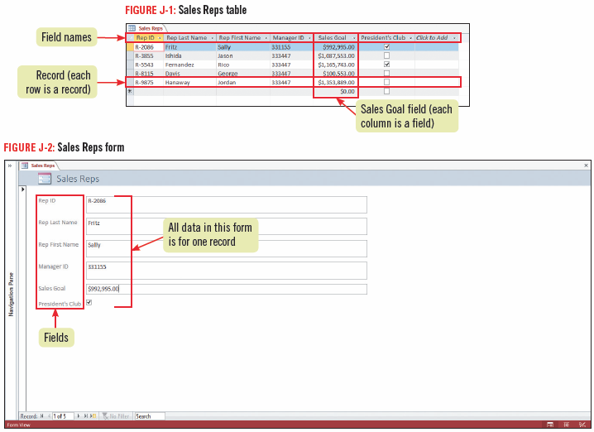
Understanding Databases

Slide 9
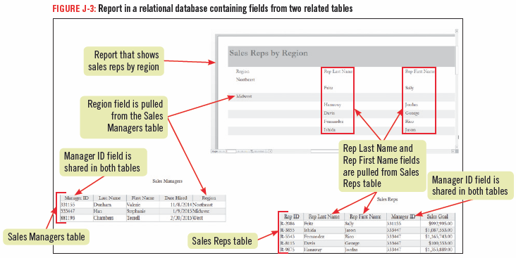
Understanding Databases

Slide 10
Creating a Database
There are two basic ways to create an Access database:
starting with a blank database, or
using a template
Creating a database from a template can save time as it contains ready-made database objects such as tables with field names appropriate to a particular type of database
When you first start Access, the Start screen opens and displays a variety of templates you can use

Slide 11
Creating a Database
With the Access program window open, below the Ribbon there are two panes
the right pane, is a blank table datasheet with a temporary table name, Table 1
the left pane is called the Navigation pane, this is where all database objects for the open database are listed

Slide 12
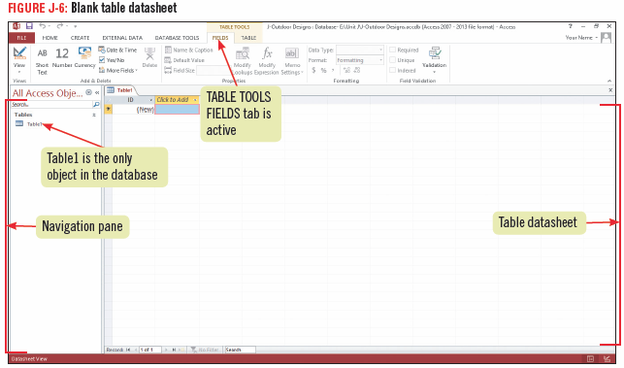
Creating a Database

Slide 13
Creating a Table in Datasheet View
When working in a new database, a blank table opens in Datasheet view
In Datasheet view, you can add fields and view the data contained in the table
Before beginning to add fields to a table it is a good idea to save the table with an appropriate name
Each object within an Access database that you create will need to be saved

Slide 14
Creating a Table in Datasheet View
To add a field to a table, you need to specify its data type, such as Date or Currency, and then specify a name
Every table in a database must contain one field that is designated as the primary key field, which uniquely identifies each record among all other records in the database
Be default, every blank new table in Access includes a blank ID field which is automatically designated the primary key field, but can be changed

Slide 15
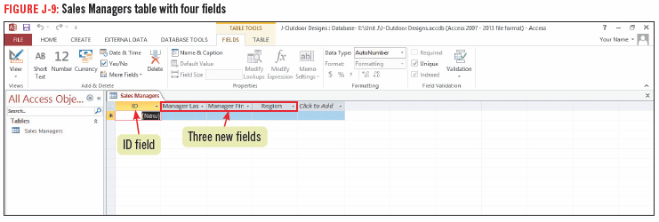
Creating a Table in Datasheet View

Slide 16
Creating a Table in Datasheet View

Slide 17
Creating a Table in Design View
It is often easier to add fields to a new or an existing table using Design view
In Design view, you use a grid to enter fields and specify field data types
In addition you can add field descriptions that identify the purpose of a field and help users understand the information that the field is meant to contain
Use Design view to view and change the designated primary key field

Slide 18
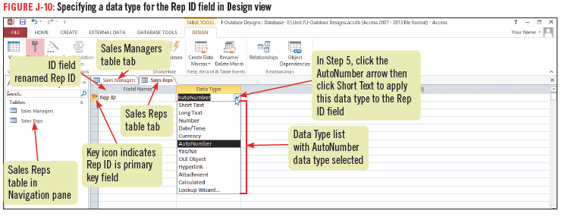
Creating a Table in Design View

Slide 19
Modifying a Table and Setting Properties
After creating a table, you may need to make changes to it such as adding or deleting a field, descriptions, or renaming a field
Design View is the best view for modifying a table structure
In Design view you can set Field properties
Field properties are data characteristics that dictate how Access stores, handles, and displays field data

Slide 20
Modifying a Table and Setting Properties
If a field name is long, is technical, or uses abbreviations, you may want to change its Caption property
The Caption property is a label that appears in a form or in Datasheet view in place of a field name
Use the Field Properties pane to view and change properties for a selected field

Slide 21
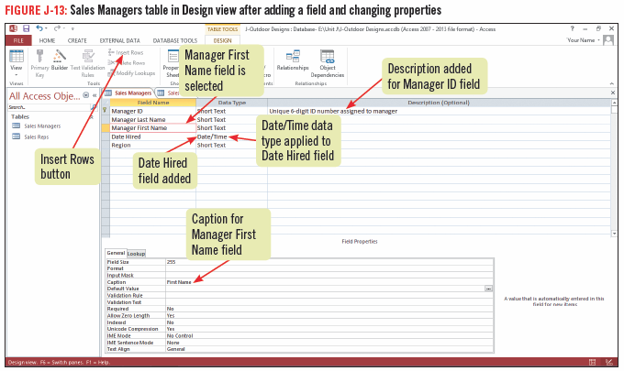
Modifying a Table and Setting Properties

Slide 22
Entering Data in a Table
To enter data in a table using Datasheet view, click where you want to enter a value and start typing
Each row of the table is one record
A row selector to the left of each record lets you select a record or records
The field names at the top of each column identify the fields
The data you enter in each field is called a field value

Slide 23
Entering Data in a Table

Slide 24
Entering Data in Datasheet View
The data in a database is dynamic and always changing
The data constantly need updating to reflect changes
To keep the data in a database current, you need to add and delete records and make edits to individual fields
You can easily edit data in a table in Datasheet view using the editing skills you learned for Word and Excel

Slide 25
Entering Data in Datasheet View
To edit a field value, you need to select either the entire field value or the part of it you want to edit and type the replacement data
When making edits in a datasheet, you may find it helpful to resize the columns to make the data easier to see
double-click the line between the columns to have the column automatically resize larger or smaller to fit the widest field name or content
drag the line between the columns to resize to a specific width

Slide 26
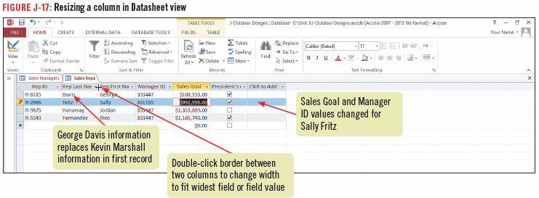
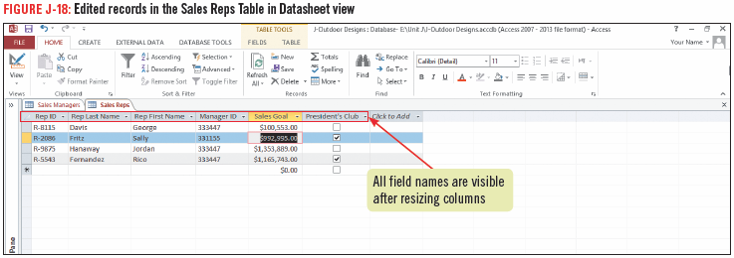
Entering Data in Datasheet View

Slide 27
Printing objects in Access
When printing information in Access you usually create a report that includes selected fields
There may also be times that you want to print a datasheet or form
To print any object in Access, select the object in the Navigation pane, click the FILE tab and then click Print
The Print page opens in the Backstage view and displays the printing options

Slide 28
Creating and Using a Form
A form is an efficient way to enter and edit data; it is easier to use and there are fewer data entry errors and less eyestrain
the simplest way to create a form is to click the Form button on the CREATE tab
A form usually displays one record at a time and contains form controls
Form controls are devices for inputting data; for example, text box, list arrow, or check box
To view different records, you use the buttons on the navigation bar

Slide 29
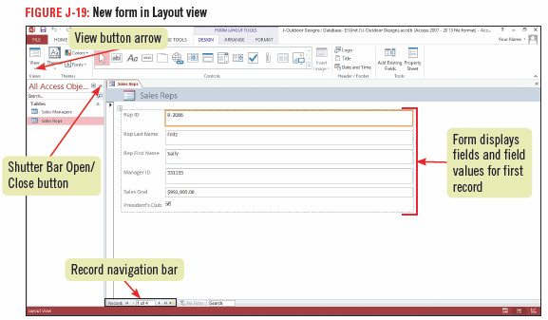
Creating and Using a Form

